Slide 1
Transport and
Climate Change Week

Slide 2
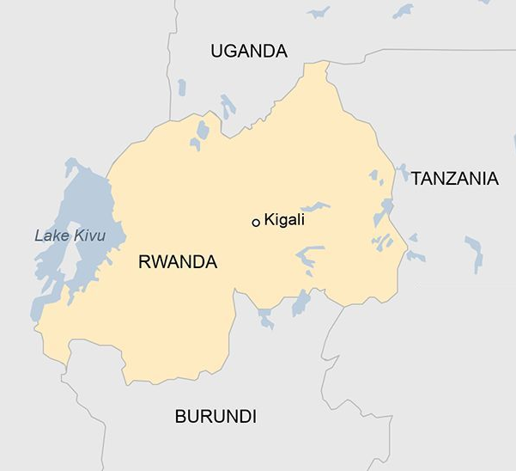
Since starting OX Rwanda Ltd. in 2021,
OX has proven demand and secured product-market fit
4 OX hubs
5,600+ customers (80% smallholder farmers)
Cargo
mix
OX Model
80% customers repeat 2x /mo.
34,500+ loads delivered
2,000+ tonnes/mo.
EUR 750K Revenue
(9M 2024)
38+ MWh used
20 Pilot Diesels
include 6 12T long-haul trucks
5+ EVs
100,000+ EV KMs driven
OX hub locations
Opening soon

Slide 3
Affordable, Reliable, Zero-Emission Trucks
Connecting Customers
100%
ELECTRIC
The world’s first purpose-built electric truck for Africa’s roads unlocks transport-as-a-service
OX is leveraging data generated by truck operations to build a trusted and scalable B2B marketplace
100% ELECTRIC
ZERO EMISSIONS
CIRCULAR​
Notes:
Solution – lines 5 & 6
4

Slide 4
Daily Unit Economics per Truck
Average Diesel Pilot 4.5T Truck (2T capacity)
Revenue/
day
Rwandan Franc
RWF 188K
RWF 63K
Labour, Hub OpEx & G&A
Diesel Unit Economics
Diesel cost of revenue
20K
Maintenance
74K
CFADS/
day
Loss after diesel truck debt payments
RWF 31K
Validated by OX’s fleet operations
40 litres at RWF 1,576/litre (Oct-2024)
Diesel truck Service, Maintenance & Repair cost
G&A includes hub admin, local business development, & DriverPlus salaries
Cash Flow Available for Debt Service (CFADS)

Slide 5
An EV truck reliably generates CFADS to repay debt
Daily Unit Economics per 4.5T EV OX Truck (2T capacity)
Revenue/
day
Rwandan Franc
RWF 188K
RWF 9K
Electricity cost of revenue
11K
Maintenance
74K
EV Unit Economics
CFADS/
day
Labour, Hub OpEx & G&A
RWF 94K
x 26 days/mo.
$1,800/mo. (Oct-2024)
Validated by OX’s fleet operations
74 kWh at RWF 111/kWh tariff
OX truck development emphasises low & preventative maintenance
G&A includes hub admin, local business development, & DriverPlus salaries
Cash Flow Available for Debt Service (CFADS)
$1,800/truck/ month available to split between EV truck debt and growth capital

Slide 6
350 trucks on the road in Rwanda and beyond
$16m revenue from East Africa
100 trucks on the road in Rwanda
$4m revenue from East Africa
OX Gen 3 truck built
$1.2m forecast revenue in Rwanda
1st OX electric truck operating in market
$800k revenue in Rwanda
OX Gen 1 truck built
1st revenues in Rwanda
OX Gen 2 truck built
$500k revenue in Rwanda
Exciting news coming soon
Founded
2020
Q4
2021
2022
2023
2024
2025
2026
Developing the technology and truck
Scaling operations internationally
Supporters & grant bodies

