Slide 1
Economic policies to decarbonise light vehicles: the French case
Arnaud Koehl, 05/11/2024

Slide 2
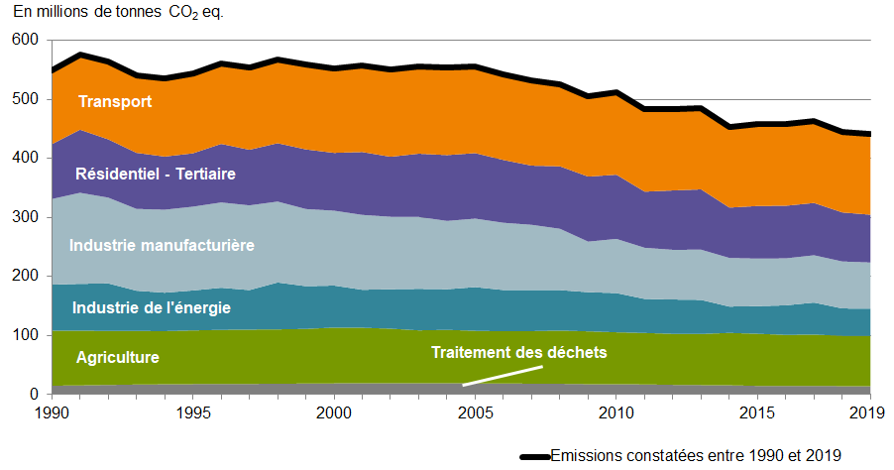
Transport is France’s most CO2-emitting sector
The transport sector is responsible for 31% of French greenhouse gas (GHG) emissions. It is the only sector to have seen its emissions increase between 1990 and 2019 (+9%).
Private cars alone are responsible for more than half of total emissions (20% LCVs and 20% HGVs).
Outdoor air pollution in our country causes 40,000 premature deaths per year (i.e. 9% of mortality in France).

Slide 3
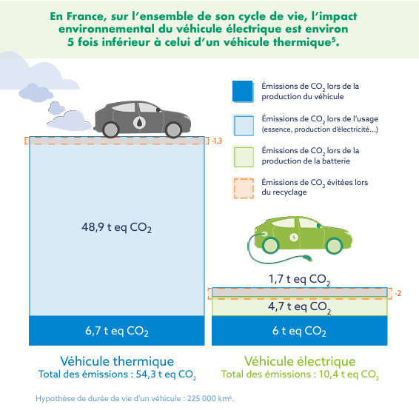
Benefits of a switch from ICE to EVs
The life cycle analysis (LCA) of private vehicles shows that electric vehicles emit on average five times less than thermal vehicles when taking into account "well-to-wheel" emissions, in the French context.
This difference is also marked with regard to hybrid and plug-in hybrid engines.
Since the availability of biofuels is limited, they will be directed towards sectors for which electrification is impossible.
The French and European strategies therefore aim for massive electrification
Source: Avere, T&E, ICCT

Slide 4
Objectives
The transition towards zero emission vehicles is thus a key lever to reach carbon neutrality (alongside mitigation of demand, modal shifts to active travel, vehicle use optimisation, …)
The French energy and climate strategy explicitly stipulates that direct electrification, i.e. battery electric vehicles (BEV), should be systematically implemented, wherever possible.
National objectives:
Phase out of new passenger cars emitting more than 123 gCO2/km by 2030
Phase out of new heavy duty vehicles using mostly fossil fuels by 2040
Full land transport decarbonisation by 2050
EU objectives :
Passenger cars and vans: end of the sales of new light internal combustion vehicles by 2035
Heavy-duty vehicles : emissions reduction targets of -15% for 2025, -45% for 2030, -65% for 2035 and -90% for 2040. Target of 90% zero emission urban buses in 2030 and 100% in 2035

Slide 5
France’s ecological planning with regard to EVs
Rapid increase in the share of EVs in sales (66% in 2030)
Catching up on total sales volume to maintain ~710kVE at an annual rate
15% of the total PV fleet electrified in 2030, i.e. 5.7 million EVs sold by 2030
100,0%
VE
ICE
Historic
PHEV
Historic
Forecast
2,2
2,3
Forecast
1,7
1,9
1,9
1,9
1,8
1,8
1,8
1,8
1,8
1,8
1,8
1,8
0,1
1,7
1,7
1,8
66%
1,6
0,5
0,3
0,4
0,6
x
0,2
0,8
0,9
=
1,0
1,2
1,3
1,4
1,5
1,7
1,8
13,1%
13,1%
0,9%
0,1%
1,2%
2015
2020
2025
2030
2035
2040
2019
2021
2023
2025
2027
2029
2031
2033
2035
2015
2020
2025
2030
2035
2040
Source : DGEC

Slide 6
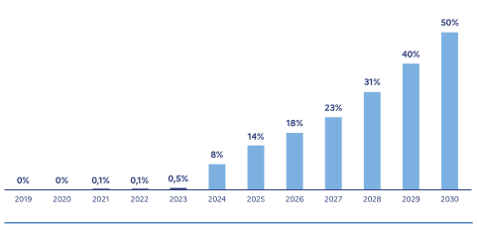
Electrification of heavy duty vehicles
Less than 1% market share in sales in 2023 but notable progress compared to previous years.
Historic and projected share of fully electric HDVs in sales:
HDV electrification is lagging far behind light vehicles, mainly because of issues related to the sector’s specific needs (range, charging, costs structures).
Annual registrations of heavy duty vehicles according to their engine, in 2022 and 2023

Slide 7
Public subsidies and incentives
1,5 billion € allocated in 2024 to support the acquisition of zero emission and low-emission vehicles
Three main schemes :
Ecological bonus : supports the acquisition of an electric car (up to 7 000 €), van, two-wheeler, three-wheeler, quadricycle, or a new bicycle
Scrapping premium : intended to accelerate the renewal of the fleet, it supports the purchase or rental of an electric or low-emission vehicle when the acquisition is accompanied by the scrapping of an old and polluting vehicle (up to 9 000 € for an electric car in a low-emission zone)
Long-term « social » leasing scheme: enabling 100 €/month rentals for electric cars (first wave of orders closed mid-February; second wave due to launch end of 2024/beginning of 2025)
Other financial incentives : clean vehicles microcredit, zero-interest loan in low emission zones
Other non financial incentives : obligations for private and public fleet managers to acquire minimum shares of low-emission vehicles. These obligations are raised over time.
Industrial targets : producing 1 million EVs per year in France by 2027 and 2 million EVs by 2030
France 2030 program : large scale investments in innovation and industrialisation
1 billion € specifically dedicated to innovative projects in the automotive sector (e.g. electric batteries)

Slide 8
Public subsidies to incentivise charging infrastucture
€100 million envelope, under the recovery plan, which helped equip service areas in the public domain of the national road network and the motorway network with high-power charging points
€10 million envelope, under the aid program supporting projects, to deploy recharging infrastructures open to the public in independent service stations, until the end of 2024
€130 million envelope, under the call for projects Heavy electric vehicle ecosystems, to support the acquisition/long-term rental of heavy electric vehicles, as well as the installation of charging stations adapted to their use
€200 million envelope, under the ADVENIR program, which is added to the 320 million euros mobilized since 2016, to finance the massive deployment of charging stations, but also the training of all stakeholders and the dissemination of information to the audiences concerned
Value-Added Tax (VTA) rate reduced to 5.5% instead of 20% for installation and maintenance work on home charging stations

Slide 9
Fiscal policy on car: CO2 malus
Tax on carbon dioxide emissions from passenger vehicles (CO2 penalty ≈ €785 million)
Target: new vehicles emitting at least 118 g of CO2/km in 2024, as part of a reduction in the scales of 5 gCO2/km/year over the last 3 years

Slide 10
Fiscal policy on car: weight malus
The tax on the running mass of passenger vehicles (weight penalty ≈ €75 million)
Targeted vehicles:
ICE cars over 1,6 tons
+100 kg for PHEV
Inclusion of HEV from 2025 onward
The tax on the mass in running order is
capped in 2024 at €60,000 by adding the
CO2 penalty and the weight penalty.

Slide 11
Thank you for your attention

Slide 12
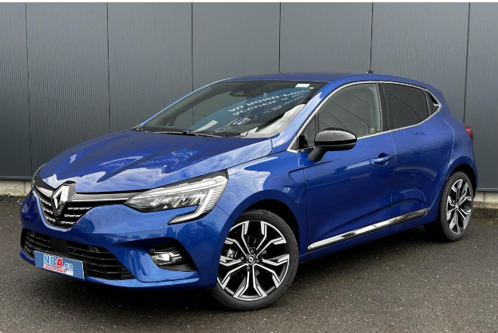
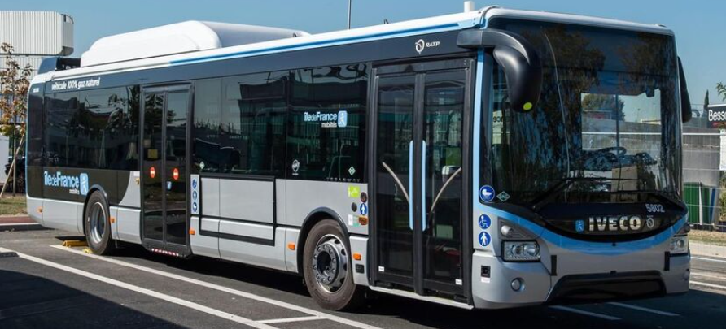
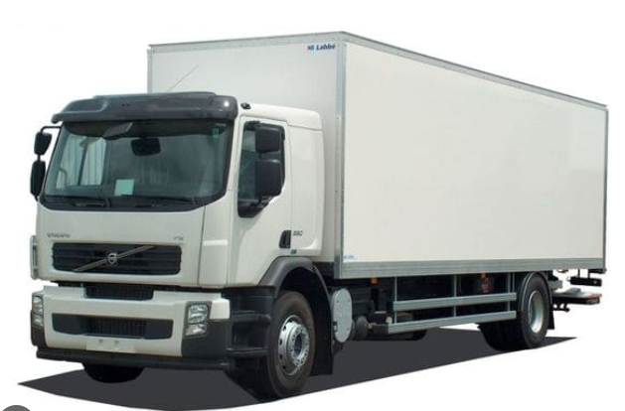
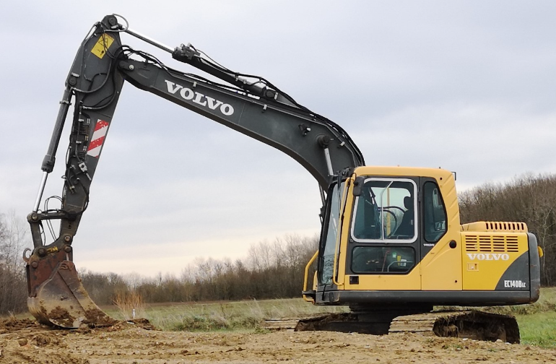
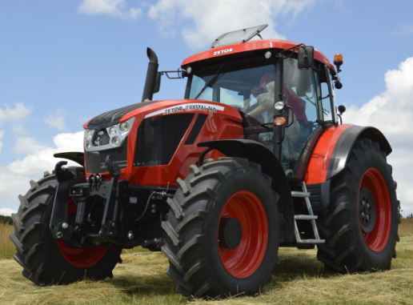
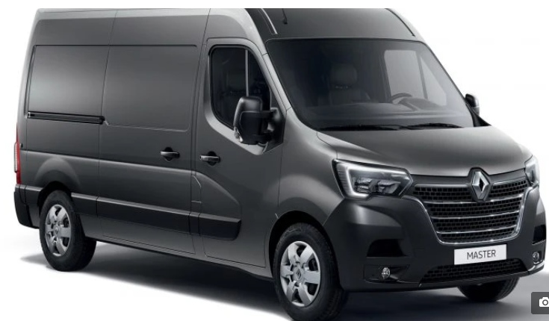
ICE retrofitting
ICE retrofitting is one additional solution to decarbonise current fleet of vehicles, in order to reach carbon neutrality as 2050 main objective
Conversion of ICE vehicles into EVs, but also into fuel-cells (H2), PHEV and biogas vehicles, depending of the needs, timeframe use and vehicle category
Vehicles
38 000 000
6 000 000
86 000
600 000
275 000
~800 000
6500 commercial ships
2200 professional leasure vessels
ICE fleet size
Average fleet age
11 years
10 years
8 years
9 years
10 years
27 years
25 years
Full electric
Hybrid
Natural gas
Full electric
Hybrid
Natural gas
H2
Full electric
Hybrid
Natural gas
H2
Full electric
Hybrid
Natural gas
H2
Full electric
Hybrid
Natural gas
H2
Full electric
B 100
Natural gas
H2
Electric/H2
Methanol/natural gas
Wind
Type of potential retrofit
12

Slide 13
ICE retrofitting
Incentives for battery or fuel cell electric retrofit:
Retrofit premium: the maximum amount reaches up to 5 000 € for the transformation of a passenger car and up to 9 000 € for the transformation of a light-duty vehicle.
Additional premium in low-emission zones (LEZ): its amount varies from 1 000 € to reach up to 3 000 € if a local subsidy of at least €2 000 is granted for the same purpose.
Zero-interest loan in LEZ: electric retrofit has been made eligible to the zero-interest loan in LEZ for the purchase by households subject to income conditions of an EV or a PHEV emitting less than 50 gCO2/km.
“Ecosystems for heavy electric vehicles” tender: launched in 2022, and renewed in 2023, with a budget of 60 million €, including 55 million € exclusively for trucks and 5 million € for coaches. All three winning coaches projects announced in September were retrofit projects. This call for project is renewed in 2024 with a budget of 130 million €.
Observation : electric retrofitting remains at a very early stage to this day for passenger cars, notably due to technical difficulties and costs linked to the adaptation of security systems, but is growing for heavier vehicles, especially coaches, as well as for low-power two- and three-wheelers.
MTE/DGEC
13

