Slide 1
100% SAF DEPLOYMENT IN SUB-SAHARAN AFRICA – AN AIRLINE PERSPECTIVE .
Subtitle: Awareness, Ambitions, and Strategies for Sustainable Aviation Fuel (SAF) Speaker: Susan Nambusi, Ag. Senior Manager Innovation & Sustainability, Kenya Airways Date: Transport & Climate change week 6th Nov 2024

Slide 2
KQ Sustainability Strategy
Purpose
Improve livelihoods in Africa by reducing inequalities and regenerating the environment.
Scope
Economic, environmental, social and governance aspects of sustainability.
Strategic Goals
1. Economic sustainability:
Long-term improved economic performance
Diversification and innovation
Supply chain engagement
2. Stakeholder Well-being:
Employee engagement, empowerment and well-being
Community engagement and social impact
Customer engagement and well-being
3. Environmental Stewardship:
Carbon emissions reduction
Reduce waste to landfill
Energy efficiency and green infrastructure
Biodiversity and ecosystem protection
4. Governance
Transparent reporting and accountability
Ethical business practices
Stakeholder engagement
Risk management

Slide 3
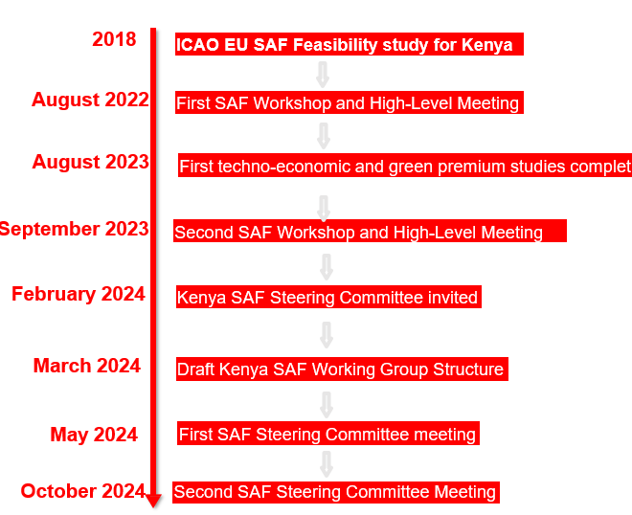
Global/ National Regulatory Agenda
ICAO
IATA
Kenya
2016- Basket of measures
2021- Net zero by 2050
2016 CORSIA volunteer
Operations improvement
Technology adavancement
Carbon offsetting (CORSIA)
Sustainable Aviation Fuel
3% Infrastructure/ Operations
13% New technologies
65% Sustainable Aviation Fuel
19% Carbon offsetting
2023- ICAO CAAF/3
Reduce CO2 by 5% using SAF and other cleaner energy by 2030

Slide 4
Current Landscape of SAF in Sub-Saharan Africa
SAF Development Status
Regional Potential
Limited production facilities and availability in Sub-Saharan Africa
Challenges
Infrastructure,
Investment
Regulatory readiness
Resources for biomass
Renewable energy
Key players and initiatives starting to explore SAF in Africa
-GIZ- Capacity building and needs assessment, EU- Act-SAF

Slide 5
Kenya’s Role as a First Mover
The beginning
2022 Kenya Airways begins to engage in conversations on SAF
First SAF powered flight
2022
Operated the first long-haul commercial flight out of
Africa, powered by SAF
Participation in various Workshops on Acceleration of Development and Deployment of SAF in Kenya
Participation in green hydrogen workshops by GIZ
Development of a comprehensive sustainability strategy
2023
SAF Partnerships
Partnership of the local development and deployment of SAF
Development of a comprehensive energy roadmap
Education and building awareness
Customer engagement (green fares)
2024
Roadmap implementation & innovation
2025 and beyond
Implementation of the SAF adoption
roadmap
2% SAF blend use in Europe routes
Innovate with local universities and research institutions on SAF
Implementation of carbon offset programs

Slide 6
Steps for Airlines to Prepare for SAF Transition
Regulatory and Policy Advocacy
Collaborating with Regional Partners
Operational level
Encourage infrastructure development
.Fleet Adaptation
Training & Operational Adjustments:
Training for crew and technical staff on SAF-specific procedures. Reviewing operational changes for SAF compatibility (fuel consumption metrics, emission tracking).
Working with government to establish supportive policies
Encouraging local aviation authorities to expedite SAF approvals for commercial use.
Exploring subsidies, grants, and tax incentives to lower SAF costs for airlines.
Building alliances with other African airlines for joint SAF procurement.
Partnering with SAF producers and researchers.

Slide 7
Opportunities, challenges and risks for 100% SAF adoption
Opportunities for Sub-Saharan African Countries
Economic Development:
Job creation through local SAF production facilities.
Potential to become a SAF export hub for neighboring regions.
Environmental Impact:
Reduced carbon footprint contributing to climate goals.
Sustainability reputation on a global stage.
Energy Security:
Increased self-reliance by reducing dependence on imported jet fuel.
Challenges and Risks in 100% SAF Deployment
Supply Chain Limitations:
Current lack of local SAF supply and complex logistics of SAF imports.
Cost Factors:
High production costs and limited economies of scale, leading to higher SAF prices.
Technological & Operational Readiness:
Technical hurdles in achieving a fleet fully compatible with 100% SAF.

Slide 8
Conclusion
SAF is essential for aviation sustainability in Sub-Saharan Africa.
Airlines can drive awareness, infrastructure development, and policy change.
A successful SAF transition will require collaborative efforts across public and private sectors.

Slide 9
Thank You

