Slide 1
Call-to-action: Let’s aim at more ambitious NDCs!
Transport and Climate Change Week #TransportWeek24
7 November 2024 I 15:30 – 17:00 CET

Slide 2
Welcome message
Andrea Palma
Technical Advisor
GIZ

Slide 3
Post-COP28 Road to NDC Update in the Transport Sector
Benjamin Welle
Director, Integrated Transport & Innovation World Resources Institute

Slide 4
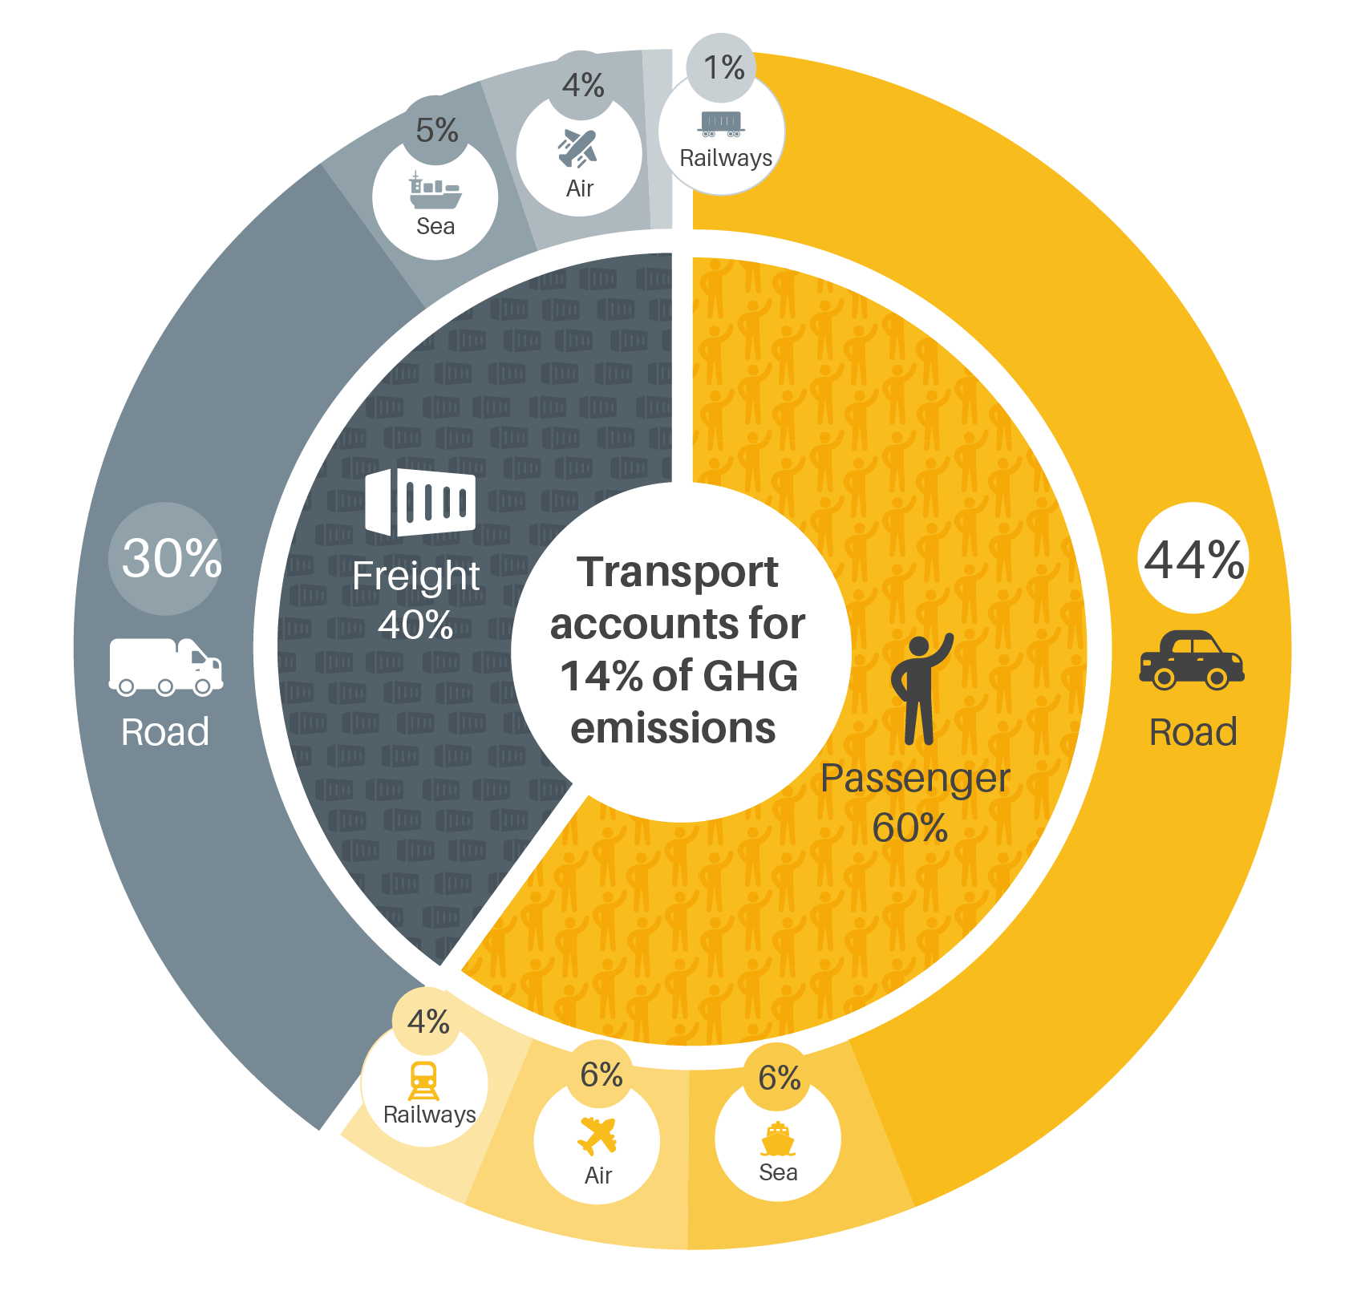
TRANSPORT EMISSIONS
Infographic source: SLOCAT
Notes:
Overall targets should: shift growth or existing energy use to clean fuels and other sustainable modes – on the global level to one third clean fuel and abating energy use by 25%, and doubling share of fossil free land transport. This is on the global level, and countries should identify the targets that places them within this global pathway. Each country may have a different recipe for making it happen, but in general this should include the mix of a comprehensive set of subsectoral targets that touch every way the world moves, from bicycles to trucks to planes. And, this should be integrating with goals to power the sector from renewable energy and other clean sources.

Slide 5
QUANTIFIED SECTORAL TARGET FOR TRANSPORT
The Global Stock Take (GST) at COP28 produced key commitments on decarbonization:
Transition away from fossil fuels
Tripling of renewable energy
Doubling of energy efficiency
Accelerate decarbonization of transport through “multiple pathways.”
Nevertheless, it did not lay out specific sectoral target for the transport sector to reach in meeting Paris goals.
Source: IEA Net Zero Roadmap
Photo: Christopher Pike/UN Climate Change
Notes:
According to the IEA, the entire transport sector will need to abate energy usage by 10 percent by 2030 and 25% by 2030, with an energy mix that goes from a 5% share of clean sources to 15% in 2030 and a third by 2035. In an ideal world, countries would be setting some high level targets on this and/or the above needs on land transport. (Though from what I am reading about Bonn there was not encouraging news on this front.) In any case, we’d like to see this then reflected by subsectoral targets that encompass both shifting to more sustainable modes (rial, public transport, active mobility) and electric mobility.
Background on doubling the share of fossil free land transport:
Double the share of energy efficient and fossil-free forms of transport – What’s in it?
Approximately 73% of passenger-kilometre (PKM) globally needs to be either shifted away from cars or to electric vehicles by 2030 to be compatible with limiting global warming to 1.5ºC. Currently, PKMs in electric vehicles and non-motorised modes is approximately 34% globally. We need to double the share of energy efficient and fossil-free land transport. Starting points, circumstances and needs differ. The target provides flexibility to combine the elements for defining national and sub-national pathways.
This target “double the share” results from the combination of two metrics, namely:
(1) The share of light-duty vehicles (LDVs) fleet that needs to be electric by 2030 in a scenario compatible with the 1.5ºC target , converted into passenger – kilometre (based on average PKM per LDV, as per data from the International Transport Forum). This provides the total PKMs that need to be in electric vehicles by 2030.
(2) The mode shift away from LDVs in PKM that needs to happen by 2030 in a scenario compatible with the 1.5ºC target.
In places where high mode shares of public transport, walking and cycling, as well as electrified vehicle and railways already exist, while populations and transport demand are growing, the target is to maintain high mode shares and avoid increases in trips made by private motorised vehicles and fossil-powered land transport.

Slide 6
QUANTIFIED SECTORAL TARGET FOR TRANSPORT
A recent IEA report has noted that “setting a quantified global goal for 2030 and beyond could accelerate action to decarbonise the road transport sector.”
Source: IEA Net Zero Roadmap
Source: https://www.iea.org/reports/from-taking-stock-to-taking-action
Notes:
According to the IEA, the entire transport sector will need to abate energy usage by 10 percent by 2030 and 25% by 2030, with an energy mix that goes from a 5% share of clean sources to 15% in 2030 and a third by 2035. In an ideal world, countries would be setting some high level targets on this and/or the above needs on land transport. (Though from what I am reading about Bonn there was not encouraging news on this front.) In any case, we’d like to see this then reflected by subsectoral targets that encompass both shifting to more sustainable modes (rial, public transport, active mobility) and electric mobility.
Background on doubling the share of fossil free land transport:
Double the share of energy efficient and fossil-free forms of transport – What’s in it?
Approximately 73% of passenger-kilometre (PKM) globally needs to be either shifted away from cars or to electric vehicles by 2030 to be compatible with limiting global warming to 1.5ºC. Currently, PKMs in electric vehicles and non-motorised modes is approximately 34% globally. We need to double the share of energy efficient and fossil-free land transport. Starting points, circumstances and needs differ. The target provides flexibility to combine the elements for defining national and sub-national pathways.
This target “double the share” results from the combination of two metrics, namely:
(1) The share of light-duty vehicles (LDVs) fleet that needs to be electric by 2030 in a scenario compatible with the 1.5ºC target , converted into passenger – kilometre (based on average PKM per LDV, as per data from the International Transport Forum). This provides the total PKMs that need to be in electric vehicles by 2030.
(2) The mode shift away from LDVs in PKM that needs to happen by 2030 in a scenario compatible with the 1.5ºC target.
In places where high mode shares of public transport, walking and cycling, as well as electrified vehicle and railways already exist, while populations and transport demand are growing, the target is to maintain high mode shares and avoid increases in trips made by private motorised vehicles and fossil-powered land transport.

Slide 7
SETTING KEY TARGETS FOR THE TRANSPORT SECTOR
Emissions goal: Cut emissions in transport by more than half by 2035
Sectoral goal: reach a quarter drop in overall energy demand and shifting to one-third green fuels by 2035
Land transport: double the share of fossil fuel free transport by 2030
Source: IEA Net Zero Roadmap
Notes:
According to the IEA, the entire transport sector will need to abate energy usage by 10 percent by 2030 and 25% by 2030, with an energy mix that goes from a 5% share of clean sources to 15% in 2030 and a third by 2035. In an ideal world, countries would be setting some high level targets on this and/or the above needs on land transport. (Though from what I am reading about Bonn there was not encouraging news on this front.) In any case, we’d like to see this then reflected by subsectoral targets that encompass both shifting to more sustainable modes (rial, public transport, active mobility) and electric mobility.
Background on doubling the share of fossil free land transport:
Double the share of energy efficient and fossil-free forms of transport – What’s in it?
Approximately 73% of passenger-kilometre (PKM) globally needs to be either shifted away from cars or to electric vehicles by 2030 to be compatible with limiting global warming to 1.5ºC. Currently, PKMs in electric vehicles and non-motorised modes is approximately 34% globally. We need to double the share of energy efficient and fossil-free land transport. Starting points, circumstances and needs differ. The target provides flexibility to combine the elements for defining national and sub-national pathways.
This target “double the share” results from the combination of two metrics, namely:
(1) The share of light-duty vehicles (LDVs) fleet that needs to be electric by 2030 in a scenario compatible with the 1.5ºC target , converted into passenger – kilometre (based on average PKM per LDV, as per data from the International Transport Forum). This provides the total PKMs that need to be in electric vehicles by 2030.
(2) The mode shift away from LDVs in PKM that needs to happen by 2030 in a scenario compatible with the 1.5ºC target.
In places where high mode shares of public transport, walking and cycling, as well as electrified vehicle and railways already exist, while populations and transport demand are growing, the target is to maintain high mode shares and avoid increases in trips made by private motorised vehicles and fossil-powered land transport.

Slide 8
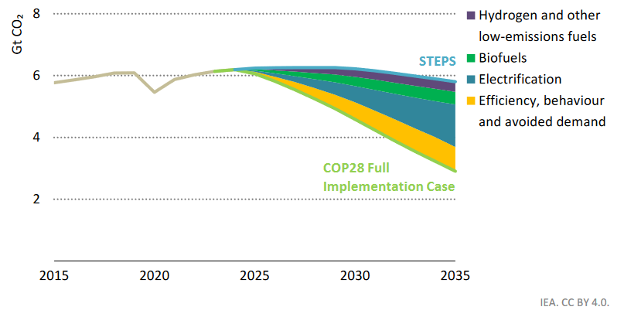
MULTIPLE PATHWAYS OF DECARBONIZATION
Emissions reductions by lever in road transport sector, COP28 full implementation
Emissions need to be roughly halved by 2035, according to the IEA recent analysis of COP28 commitments
Source: IEA Net Zero Roadmap
Notes:
According to the IEA, the entire transport sector will need to abate energy usage by 10 percent by 2030 and 25% by 2030, with an energy mix that goes from a 5% share of clean sources to 15% in 2030 and a third by 2035. In an ideal world, countries would be setting some high level targets on this and/or the above needs on land transport. (Though from what I am reading about Bonn there was not encouraging news on this front.) In any case, we’d like to see this then reflected by subsectoral targets that encompass both shifting to more sustainable modes (rial, public transport, active mobility) and electric mobility.
Background on doubling the share of fossil free land transport:
Double the share of energy efficient and fossil-free forms of transport – What’s in it?
Approximately 73% of passenger-kilometre (PKM) globally needs to be either shifted away from cars or to electric vehicles by 2030 to be compatible with limiting global warming to 1.5ºC. Currently, PKMs in electric vehicles and non-motorised modes is approximately 34% globally. We need to double the share of energy efficient and fossil-free land transport. Starting points, circumstances and needs differ. The target provides flexibility to combine the elements for defining national and sub-national pathways.
This target “double the share” results from the combination of two metrics, namely:
(1) The share of light-duty vehicles (LDVs) fleet that needs to be electric by 2030 in a scenario compatible with the 1.5ºC target , converted into passenger – kilometre (based on average PKM per LDV, as per data from the International Transport Forum). This provides the total PKMs that need to be in electric vehicles by 2030.
(2) The mode shift away from LDVs in PKM that needs to happen by 2030 in a scenario compatible with the 1.5ºC target.
In places where high mode shares of public transport, walking and cycling, as well as electrified vehicle and railways already exist, while populations and transport demand are growing, the target is to maintain high mode shares and avoid increases in trips made by private motorised vehicles and fossil-powered land transport.

Slide 9
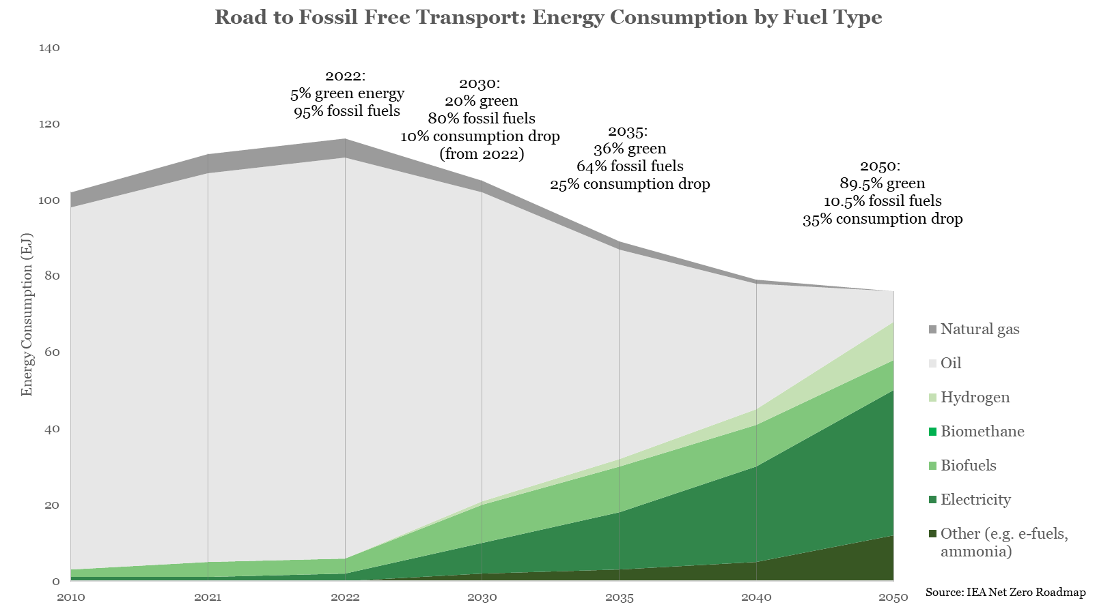
ROAD TO FOSSIL FUEL FREE TRANSPORT
A sectoral target on energy demand and fuels is another option for a global target.
The path: quarter drop in overall energy demand and shifting to one-third green sources by 2035
Source: https://www.iea.org/reports/net-zero-roadmap-a-global-pathway-to-keep-the-15-0c-goal-in-reach
Notes:
According to the IEA, the entire transport sector will need to abate energy usage by 10 percent by 2030 and 25% by 2030, with an energy mix that goes from a 5% share of clean sources to 15% in 2030 and a third by 2035. In an ideal world, countries would be setting some high level targets on this and/or the above needs on land transport. (Though from what I am reading about Bonn there was not encouraging news on this front.) In any case, we’d like to see this then reflected by subsectoral targets that encompass both shifting to more sustainable modes (rial, public transport, active mobility) and electric mobility.
Background on doubling the share of fossil free land transport:
Double the share of energy efficient and fossil-free forms of transport – What’s in it?
Approximately 73% of passenger-kilometre (PKM) globally needs to be either shifted away from cars or to electric vehicles by 2030 to be compatible with limiting global warming to 1.5ºC. Currently, PKMs in electric vehicles and non-motorised modes is approximately 34% globally. We need to double the share of energy efficient and fossil-free land transport. Starting points, circumstances and needs differ. The target provides flexibility to combine the elements for defining national and sub-national pathways.
This target “double the share” results from the combination of two metrics, namely:
(1) The share of light-duty vehicles (LDVs) fleet that needs to be electric by 2030 in a scenario compatible with the 1.5ºC target , converted into passenger – kilometre (based on average PKM per LDV, as per data from the International Transport Forum). This provides the total PKMs that need to be in electric vehicles by 2030.
(2) The mode shift away from LDVs in PKM that needs to happen by 2030 in a scenario compatible with the 1.5ºC target.
In places where high mode shares of public transport, walking and cycling, as well as electrified vehicle and railways already exist, while populations and transport demand are growing, the target is to maintain high mode shares and avoid increases in trips made by private motorised vehicles and fossil-powered land transport.

Slide 10
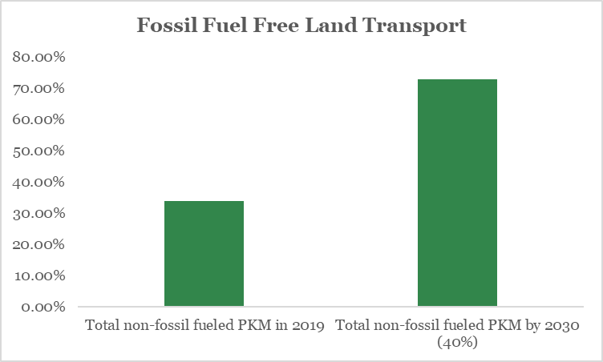
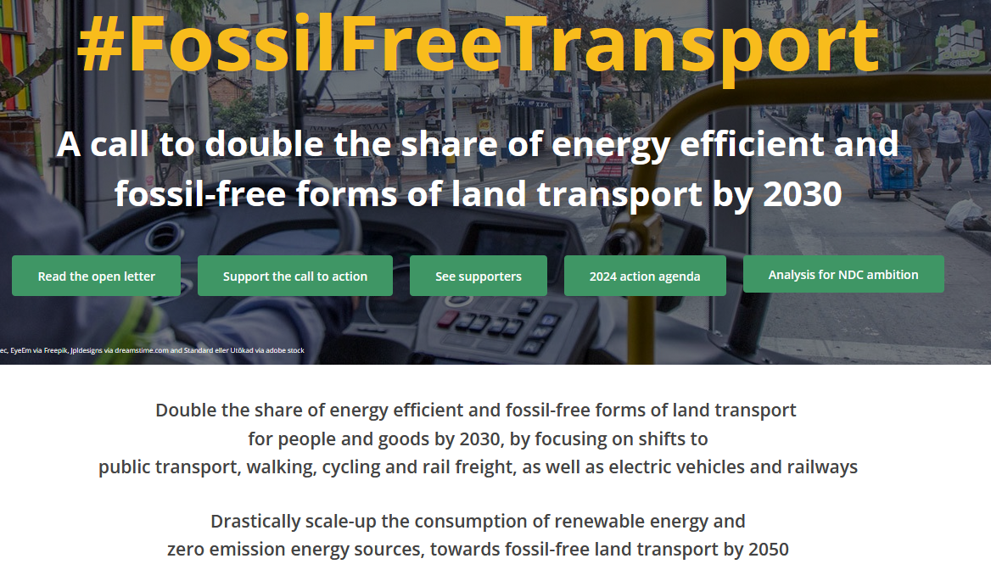
FOSSIL FUEL FREE LAND TRAVEL
A group of organizations and 2 countries at COP28 called for doubling the share of fossil free land transport by 2030
Infographic source: Call to Action
Notes:
Overall targets should: shift growth or existing energy use to clean fuels and other sustainable modes – on the global level to one third clean fuel and abating energy use by 25%, and doubling share of fossil free land transport. This is on the global level, and countries should identify the targets that places them within this global pathway. Each country may have a different recipe for making it happen, but in general this should include the mix of a comprehensive set of subsectoral targets that touch every way the world moves, from bicycles to trucks to planes. And, this should be integrating with goals to power the sector from renewable energy and other clean sources.

Slide 11
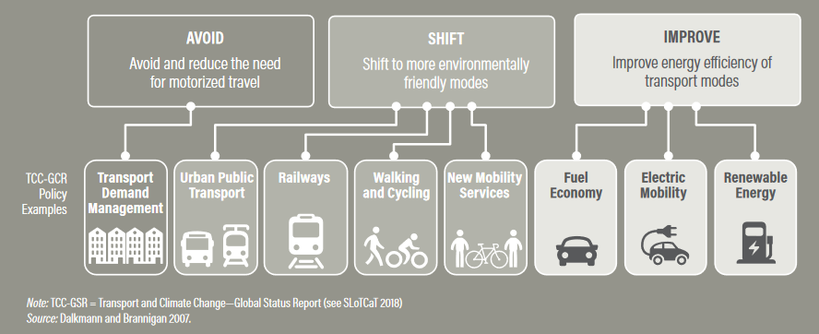
AVOID SHIFT IMPROVE KEY TO A COMPREHENSIVE NDC
Source: Avoid Shift Improve – Dalkmann & Brannigan; WRI Opportunities for Transport and NDCs
Notes:
According to the IEA, the entire transport sector will need to abate energy usage by 10 percent by 2030 and 25% by 2030, with an energy mix that goes from a 5% share of clean sources to 15% in 2030 and a third by 2035. In an ideal world, countries would be setting some high level targets on this and/or the above needs on land transport. (Though from what I am reading about Bonn there was not encouraging news on this front.) In any case, we’d like to see this then reflected by subsectoral targets that encompass both shifting to more sustainable modes (rial, public transport, active mobility) and electric mobility.
Background on doubling the share of fossil free land transport:
Double the share of energy efficient and fossil-free forms of transport – What’s in it?
Approximately 73% of passenger-kilometre (PKM) globally needs to be either shifted away from cars or to electric vehicles by 2030 to be compatible with limiting global warming to 1.5ºC. Currently, PKMs in electric vehicles and non-motorised modes is approximately 34% globally. We need to double the share of energy efficient and fossil-free land transport. Starting points, circumstances and needs differ. The target provides flexibility to combine the elements for defining national and sub-national pathways.
This target “double the share” results from the combination of two metrics, namely:
(1) The share of light-duty vehicles (LDVs) fleet that needs to be electric by 2030 in a scenario compatible with the 1.5ºC target , converted into passenger – kilometre (based on average PKM per LDV, as per data from the International Transport Forum). This provides the total PKMs that need to be in electric vehicles by 2030.
(2) The mode shift away from LDVs in PKM that needs to happen by 2030 in a scenario compatible with the 1.5ºC target.
In places where high mode shares of public transport, walking and cycling, as well as electrified vehicle and railways already exist, while populations and transport demand are growing, the target is to maintain high mode shares and avoid increases in trips made by private motorised vehicles and fossil-powered land transport.

Slide 12
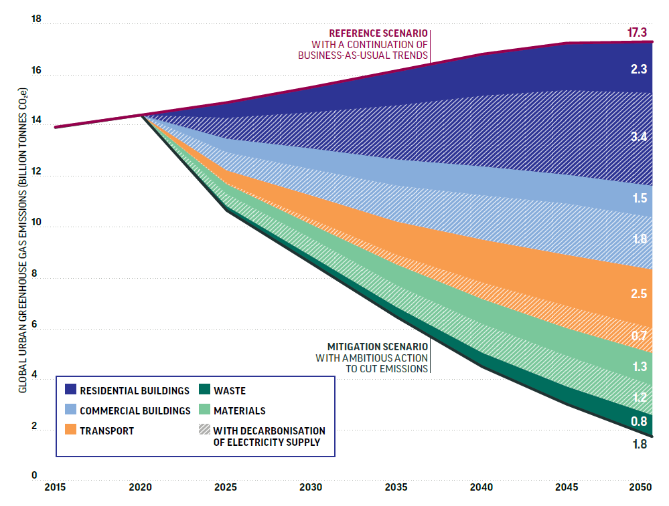
THE URBAN MITIGATION POTENTIAL
TECHNICALLY FEASIBLE POTENTIAL TO REDUCE GREENHOUSE GAS EMISSIONS FROM CITIES, BY 2050, BY SECTOR
Solutions possible today can cut emissions by 90%, generate energy and material savings worth US$24 trillion and support 45 million jobs by 2050
Source: Stockholm Environmental Institute and Vivid Economics for the Coalition for Urban Transitions (2019) * Excluding decarbonisation of electricity
Notes:
And by investing in cities, national governments can help cut emissions from buildings, transport, materials use and waste by almost 90%, drawing on existing and feasible technologies, and generating savings worth almost US$24 trillion by 2050
And the same is true for adaptation. Cities – like Delhi, Porto Alegre and Nairobi - are on the frontline of climate impacts

Slide 13
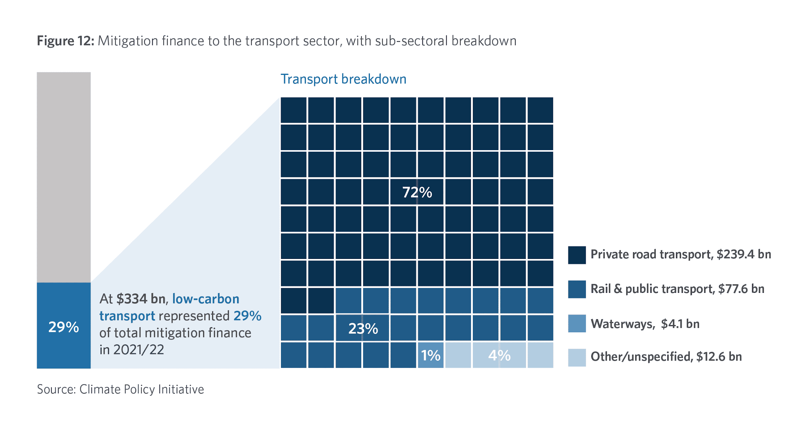
GLOBAL CLIMATE FINANCE LANDSCAPE FOR TRANSPORT
At minimum, we need
4.7x
current finance levels
Source: Climate Policy Initiative, 2023
Note: “Other” low-carbon transport support areas include transport infrastructure projects such as roads, urban transit, and EV charging infrastructure. Source: CPI Global Landscape of Climate Finance 2023
Notes:
Low-carbon transport finance reached an all-time high of USD 334 billion per year, in 2021/2022, accounting for 29% of mitigation finance (1.27 trillion total)
- Private road transport (private EVs) dominated investment in the sector (72%), followed by rail and public transport (23%). CPI did not include BRTs in this number because they deemed them not to be climate finance because they run on diesel. I would beg to say these are in fact climate finance.
- Transport is one sector where infrastructure and fleets require significant investment, and it’s estimated that finance in the sector needs to go an additional $ 2.4 trillion per year between now and 2050. So how to improve the access to finance for transport?
- Finance for private road transport reached USD 239 billion in 2021/2022. Public subsidies represented 13% of total private road transport finance.
- EV markets are maturing and becoming competitive, especially for cars, and public subsidies are therefore now shifting to areas such as heavy transport and charging infrastructure.

Slide 14
Thank you
benjamin.welle@wri.org BLOG: TheCityFix.com
WEB: WRI.org
BEN WELLE, DIRECTOR INTEGRATED TRANSPORT

Slide 15
Current state of NDCs:
Are we on track?
Nikola Medimorec
Director, Data Analysis and Research
SLOCAT

Slide 16
SLOCAT is the international, multi-stakeholder partnership powering systemic transformations and a just transition towards equitable, healthy, green and resilient transport and mobility systems for the people and the planet. We deliver on our mission through co-creation, co-leadership and co-delivery across knowledge, advocacy and dialogue activities in the intersection between transport, climate change and sustainability.
Our multi-sectoral Partnership engages a vibrant and inclusive ecosystem across transport associations, NGOs, academia, governments, multilateral organisations, philanthropy and business; as well as a large community of world-class experts and change-makers. Going where others do not or cannot go individually, our Partnership is leveraged to set ambitious global agendas and catalyse progressive thinking and solutions for the urgent transformation of transport and mobility systems worldwide.
Our mission
SLOCAT enables collaborative knowledge and action for sustainable, low carbon transport, and brings the voice of the movement into international climate change and sustainability processes.

Slide 17
Agenda
Why we need to act now
Are NDCs on track to keep global warming to 1.5ºC?
Urgent action on ambition, finance and capacity needed

Slide 18
I. Why we need to act now

Slide 19
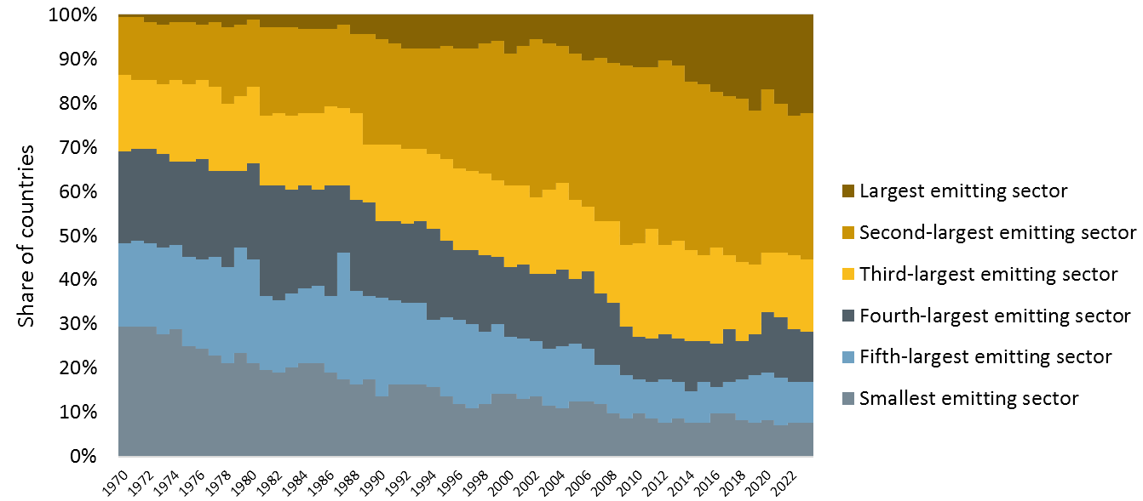
Transport is a significant contributor to global GHG emissions
Transport was responsible for 15.9% of global GHG emissions in 2023, second-largest sector after the power industry.
Transport recorded the strongest year-on-year increase among all sectors, growing by 3.7% from 2022 to 2023.
Transport's contribution to a country's greenhouse gas emissions
Over 50% of countries record transport as the largest or second- largest GHG emitting sector in 2023.
Source: SLOCAT analysis based on EDGAR, https://edgar.jrc.ec.europa.eu/report_2024
Notes:
In 2023, all modes of transport contributed 15.9% of global GHG emissions in 2023,, making it the 𝘀𝗲𝗰𝗼𝗻𝗱-𝗹𝗮𝗿𝗴𝗲𝘀𝘁 𝘀𝗲𝗰𝘁𝗼𝗿 after the power industry.
Transport recorded the strongest year-on-year increase among all sectors, growing by 3.7% from 2022 to 2023—nearly double the overall GHG increase.
For the first time in history, low- and middle-income countries emitted more transport GHG emissions than high-income countries.

Slide 20
II. Are NDCs on track to keep global warming to 1.5ºC?

Slide 21
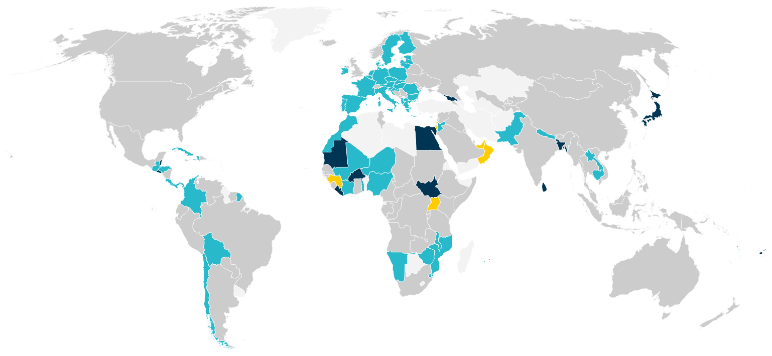
Too few NDCs include transport GHG mitigation targets
Targets
42% of second-generation NDCs contain transport targets (either transport GHG mitigation targets and/or other quantitative targets for transport).
However, only 24 second-generation NDCs have a transport GHG mitigation target, representing 16% of all second-generation NDCs.
Source: GIZ-SLOCAT, NDC Transport Tracker, https://changing-transport.org/tracker/
Notes:
Nikola
Our assessment shows that while 42% of second-generation NDCs contain some type of transport target, just 16% feature a transport GHG mitigation target.
There are 24 second-generation NDCs with a transport GHG mitigation target, twice as much as we had in the first generation of NDCs. The transport GHG mitigation targets by these 24 NDCs aim to reduce transport emissions or at least they intend to slow down transport emission growth compared to business-as-usual projections until 2030. As the map indicates, the NDCs with targets are mainly from Africa and Asia.
The map also shows the additional, so-called non-GHG transport targets, which focus on increasing public transport usage or aim at the increase of zero-emission vehicles by a specific year.

Slide 22
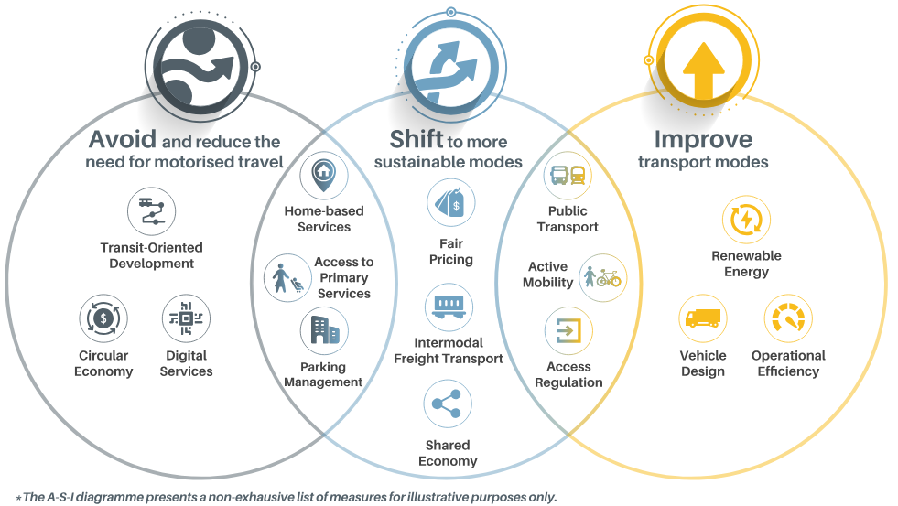
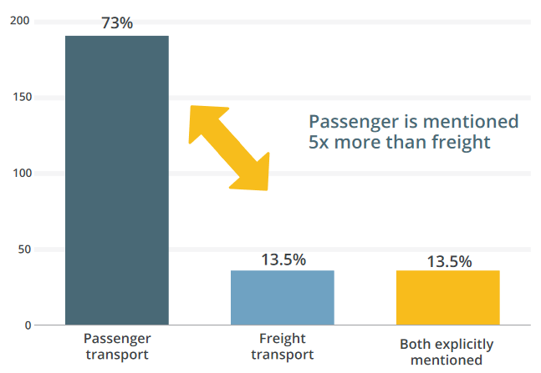
Full potential of inclusion of Avoid and Shift actions has not yet been reached. Improve actions dominate in the LTS and second-generation NDCs.
Mitigation Actions
There are nearly twice as many transport mitigation actions featured in each second-generation NDC compared to first-generation NDCs.
Electric mobility is the most common mitigation action in second-generation NDCs.
Imbalance of Avoid-Shift-Improve (12% Avoid, 28% Shift, 60% Improve).
Second-generation NDCs focus more on passenger than freight transport (split of 5:1), a decline compared to the first generation of NDCs (4:1).
Number of measures in second-generation NDCs
With explicit mentions of passenger and/or freight transport
Source: SLOCAT, Refocusing ASI, https://slocat.net/asi/
Source: GIZ-SLOCAT, NDC Transport Tracker, https://changing-transport.org/tracker/
Notes:
Nikola
Looking at mitigation actions, we can see that there is a lot more relevant content in the second-generation than in the first-generation NDCs. There are nearly twice as many transport mitigation actions compared to the first generation of NDCs.
Electric mobility is the most common mitigation action. 59% of second-generation NDCs and 90% of LTS contain actions on transport electrification.
We can see strong imbalance between Avoid, Shift and Improve. Improve actions dominate in NDCs and LTS.
Another issue that we discovered is that there are more passenger than freight-related mitigation actions. The situation was actually better in the first-generation NDCs. However, freight transport causes nearly half of all land transport GHG emissions, so it’s important to strengthen the role of freight transport mitigation.

Slide 23
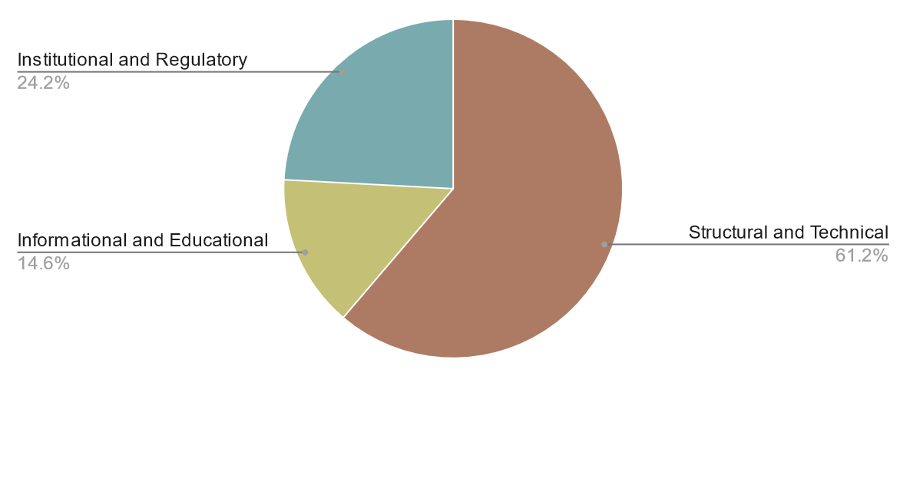
Transport adaptation targets and actions are still limited
Adaptation and resilience
Adaptation actions in second-generation NDCs
The adaptation content is very general and superficial, majority is focusing on road infrastructure resilience.
Over 60% of actions focus on structural and technical approaches.
Only 8 NDCs have transport adaptation targets, covering activities around climate-proof infrastructure and support for more robust and resilient transport systems.
Source: GIZ-SLOCAT, NDC Transport Tracker, https://changing-transport.org/tracker/
Notes:
Nikola
On the topic of adaptation and resilience, transport-related content is still limited. The actions outlined are very general and lack any details. The major focus is on road infrastructure resilience without many specific actions for transport modes nor many specific mentions of freight or passenger-focused adaptation actions.
Only 8 second-generation NDCs feature transport adaptation targets. These targets aim to ensure climate-proof design standards by a specific year or aim to make transport asset resilient within the next years.

Slide 24
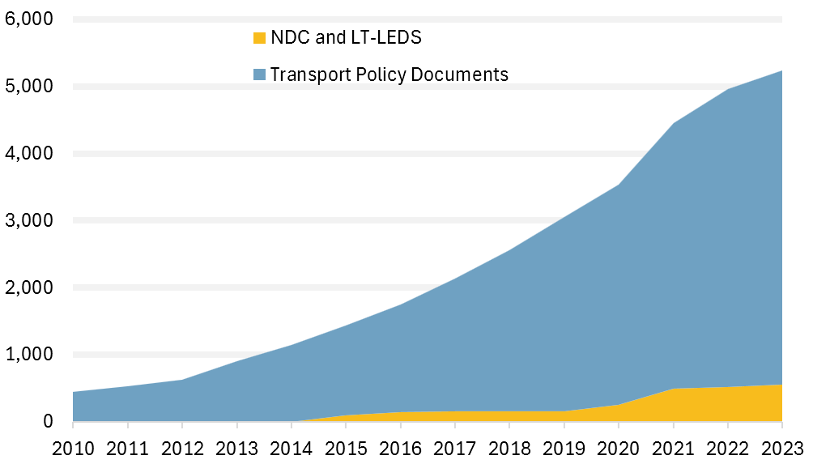
NDCs and LT-LEDS do not show the complete picture
of transport decarbonisation efforts, example of Asia-Pacific
Number of mitigation and adaptation measures
in 25 countries in Asia-Pacific
Second-generation NDCs lead to a global warming of 2.5°C to 2.9°C.
Based on an assessment of 25 countries in the Asia-Pacific region, measures in the NDCs constitute only about 10% of total measures on transport climate mitigation and adaptation set by countries in the region.
Ambition towards transport decarbonisation can be raised by better alignment of national transport policies, the NDCs and LT-LEDS.
Source: Data from the Asian Transport Outlook, featured in the HVT-SLOCAT-ESCAP policy brief “State of play of transport targets in NDCs and beyond in Asia and the Pacific”
Notes:
Nikola
Globally, the first-generation NDCs would have resulted in an increase of 3.7°C above pre-industrial levels by 2100. The second-generation NDCs lead to a global warming of 2.5°C to 2.9°C.
We have to be aware that NDCs as well as long-term strategies, so-called LT-LEDS, do not show the complete picture of transport decarbonisation efforts. This slide shows a detailed assessment of the situation in the Asia-Pacific region. The colleagues from the Asian Transport Outlook assessed 25 countries and saw that measures in the NDCs constitute only about 10% of total measures on transport climate mitigation and adaptation set by countries in the region. Many measures and activities are reflected in national policies, transport strategies, EV roadmaps and many more strategies.
It means that the ambition towards transport decarbonisation and policy coherence can be raised by better alignment between national transport policies, and with the NDCs and LT-LEDS.

Slide 25
III. Urgent action on ambition, finance and capacity needed

Slide 26
To put transport on a 1.5°C pathway, we need urgent action on ambition, finance and capacity.
Action for ambition
A race to the top
Action for finance
Transport in climate finance and the Loss & Damage Fund
Action for capacity
2030 transport targets and measures
NDCs analysis and multistakeholder dialogue towards the target of doubling the share of energy efficient and fossil-free forms of land transport for people and goods by 2030
Facts, figures and guidance about investment needs and opportunities for transport sustainability, decarbonisation, adaptation and resilience in Low- and Middle- Income Countries
Compendium of target areas and measures that countries can include in their next NDCs, including illustrative practices
Check out the webpage and the 60+ multi-stakeholder signatories, including Colombia and Chile:
https://slocat.net/call-to-action-on-fossil-fuel-free-land-transport/
Notes:
Nikola
The GIZ-SLOCAT NDC Transport Tracker is also an important support tool for SLOCAT’s advocacy activities. Last year, SLOCAT and REN21 initiated the call to double the share of energy efficient and fossil-free forms of land transport by 2030. This year we aim to conduct several activities around NDC analysis, facts and figures for finance and action for capacity in order to mode from pledges to 2030 targets and measures in the next generation of NDCs that can pragmatically put us on a 1.5 degree Celsius pathway.

Slide 27
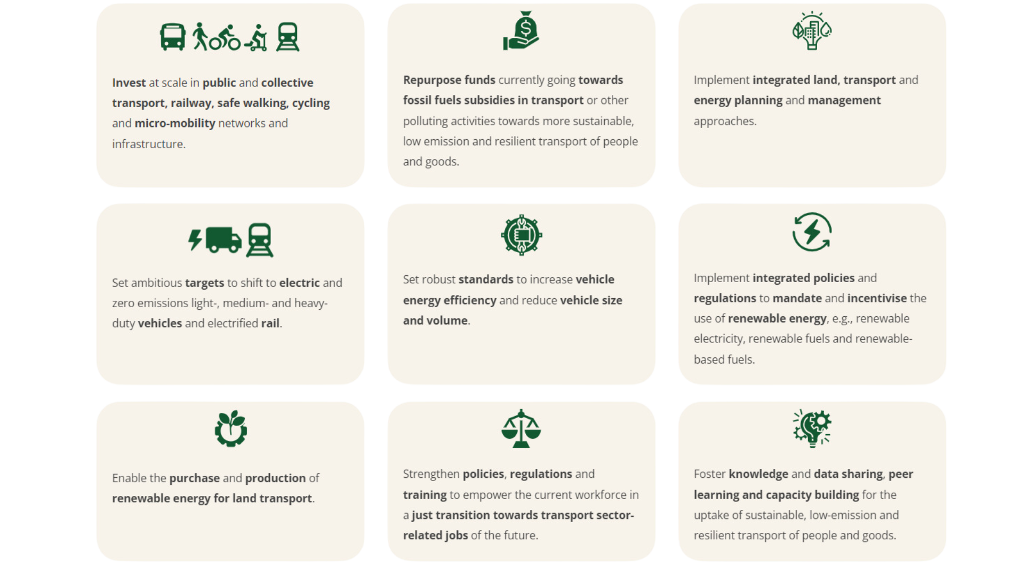
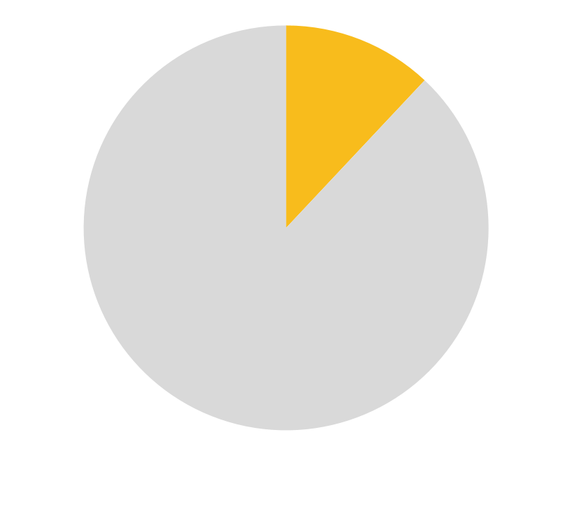
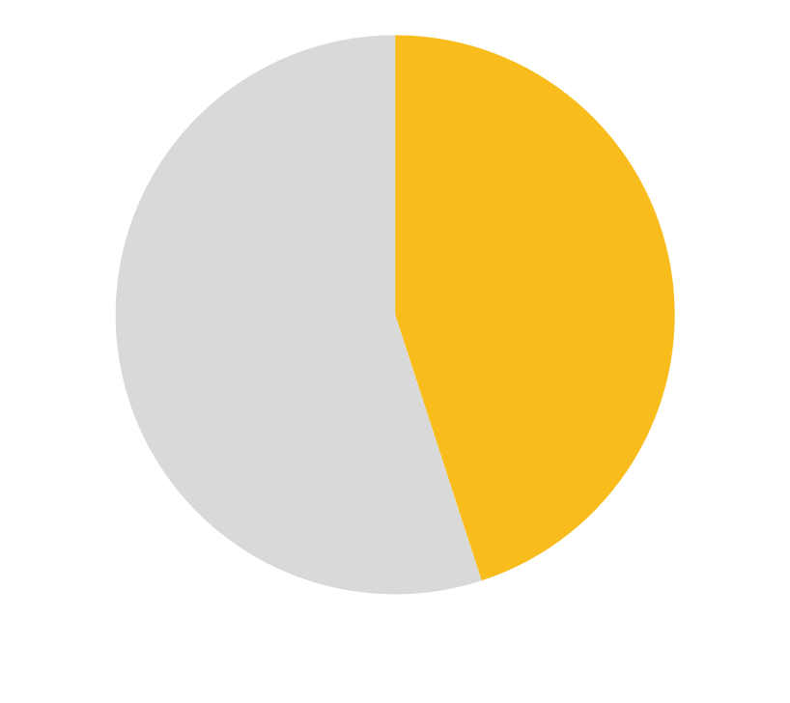
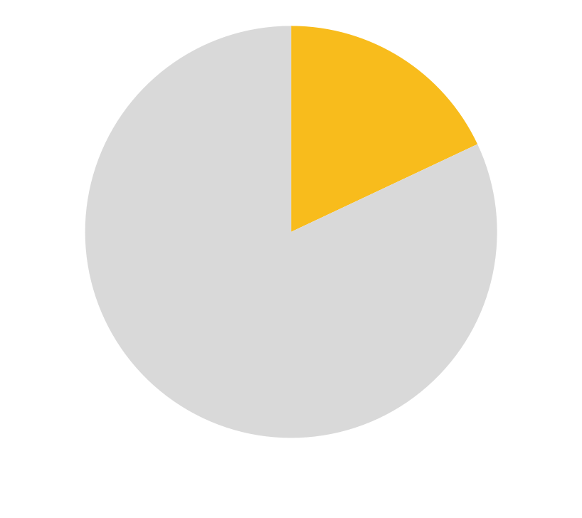
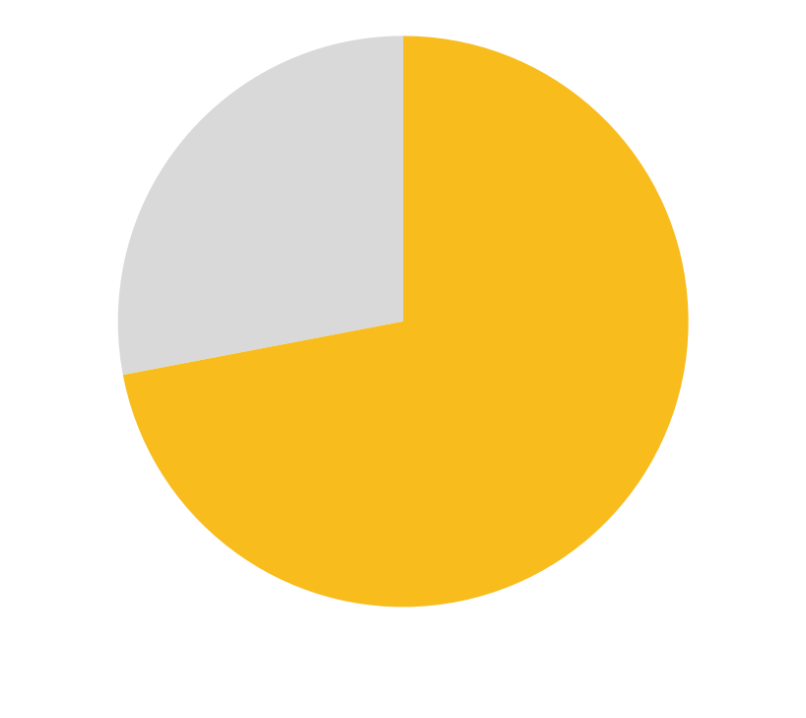
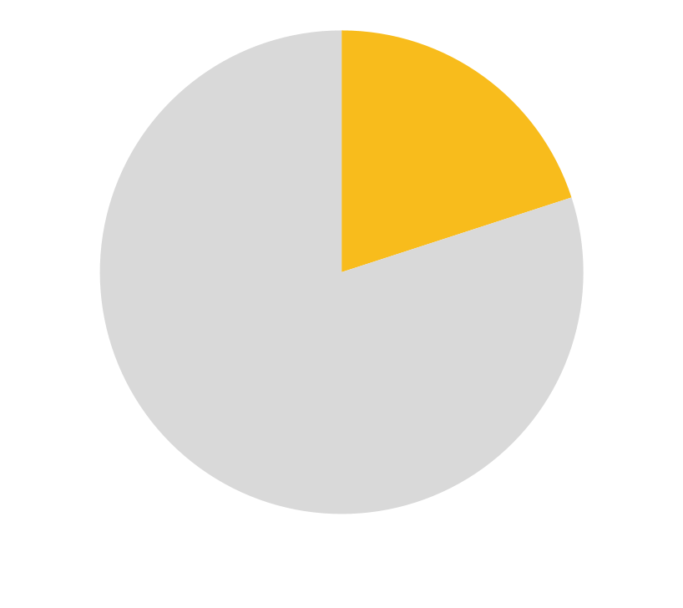
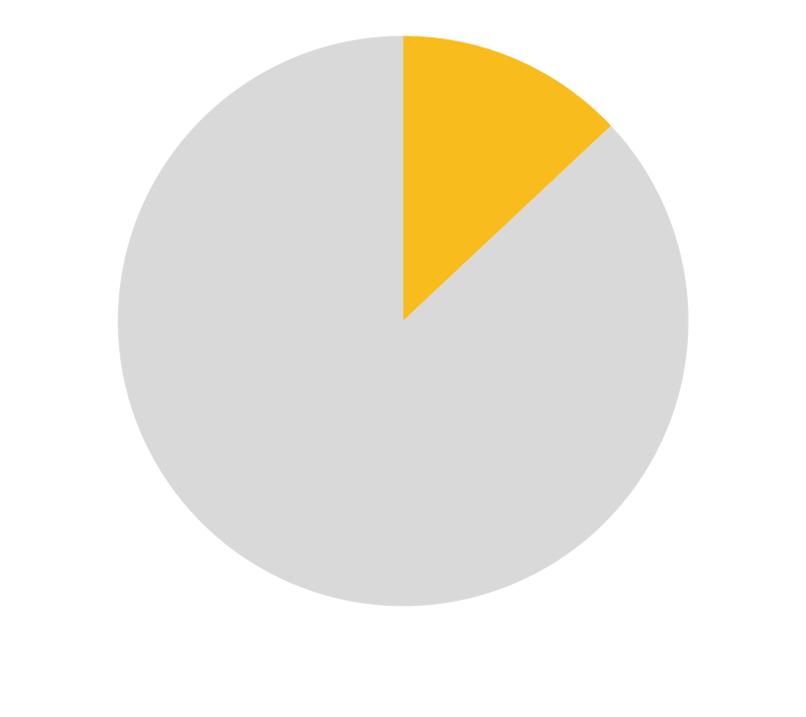
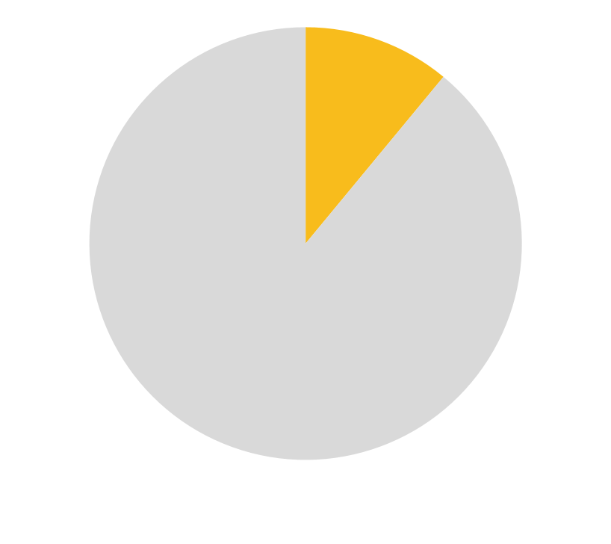
Action for ambition
A race to the top
Nine Action Areas
12%
How did the
second generation of NDCs address
the nine action areas
of the Call to Action?
45%
18%
72%
18%
45%
20%
13%
11%
Read the assessment here

Slide 28
Political ambition and capacity building for transport in the NDCs
Check out recent SLOCAT releases
NDCs Library - Guidelines, templates, tools and resources to support the next NDCs.
Freight and logistics in the NDCs, with Kühne Climate Center.
Just transition in the NDCs, with the International Federation of Transport Workers.
Stay tuned for forthcoming SLOCAT resources
Transport Decarbonisation Index: to assist Low and Middle-Income Countries in Africa and South Asia in reducing greenhouse gas emissions in surface transport by providing a diagnostic toolkit, with UK’s HVT, UEMI, Lew Fulton, Pierpaolo Cazzola, Jacob Teter.
Compendium of policy interventions on freight transport and logistics, with Kühne Climate Center: Manifesto for intermodal, low-carbon, efficient and resilient freight transport and logistics.
Transport in the NDCs of Asia-Pacific countries, with UNESCAP, UK’s HVT and ADB.
Our open source database
NDC Transport Tracker by GIZ and SLOCAT.
Climate Strategies for Transport: A SLOCAT Analysis of NDCs and Long-Term Strategies.
Regional snapshots Africa, Asia, LAC and MENA.
Notes:
Nikola
SLOCAT supports political ambition and capacity building for transport in the NDCs through several resources. This slide gives an overview of the recent and forthcoming SLOCAT products. I would very much recommend you to check out slocat.net/ndcs, where most of the listed products can be found.
The webpage functions as an NDCs Library, where guidelines, templates, tool s and more resources are collected. There you will find guidance documents by partners working on active mobility, public transport and rail on how to strengthen the next round of NDCs.

Slide 29
Explore the GIZ-SLOCAT
NDC Transport Tracker:
www.slocat.net
changing-transport.org/tracker/
nikola.medimorec@slocatpartnership.org
@slocatofficial

Slide 30
Looking ahead towards NDC 3.0
Breakout 1: Achieving a 1.5°C Future through Multiple Pathways in the Transport Sector
Breakout 2: Improving Access to Climate Finance in Transport
Breakout 3: Multistakeholder Roles and Opportunities for NDC Development and Implementation
Facilitators
Ms. Olivia Wessendorff
Advisor to the ITF Secretary
General at the OECD
Ms. Alice Yiu
Director of Outreach and Communications
SLOCAT
Ms. Yiqian Zhang
Manager, Climate and Electric Mobility
WRI Ross Center for Sustainable Cities

Slide 31
Key insights and takeaways

Slide 32
Public Transport NDCs Template
Alice Yiu (SLOCAT) on behalf of Mr. Philip Turner
Head of Sustainable Development International Association of Public Transport (UITP)

Slide 33
About the UITP NDC Template
UITP has developed this template for countries as a guide to take action to strengthen their commitments to public transport and active mobility in their Nationally Determined Contributions (NDC).
Countries can use it to explore options that reflect national priorities and address key implementation and financing needs to strengthen their NDC 3.0 2025 submissions.
Half of the world’s population lacks access to public transport
One in three countries have yet to integrate public transport strategies into their NDCs
By focusing on shifts to public transport, walking, cycling - emissions from transport would be cut by half by 2030
Read the public transport NDC template
Read the public transport analysis of NDCs

Slide 34
A four-point plan for better NDCs
The template outlines a vision for public transport that all NDCs should aim to achieve, supported by three key mobility objectives and 14 actions that can be taken to ensure better urban mobility for people and the planet.
01
02
03
04
Monitoring & Reporting
Vision
Goals
Actions
Articulate a vision for the desired state of the future that puts public transport at the heart of urban transport climate action
Set ambitious targets that mirror the global efforts called for in the COP28 Global Stocktake (GST) decision:
mode shift
infrastructure investment
low and zero emission vehicles & services
Detail the actions to reach the vision, targets and objectives:
a) Support a shift in people’s mobility habits
b) Design cities around people and invest for better mobility
c) Enable cities to drive change
Fix indicators to monitor and verify progress against the actions so it accelerates change and delivers multiple sustainability benefits.
SDG - 3.6 – 3.9 – 9.1 – 11.2 – 11.6 – 13.2 -

Slide 35
Rail NDCs Template
Ms. Lucie Anderton
Head of Sustainability and Coordinator for the North America Region
International Union of Railways (UIC)

Slide 36
Lucie Anderton
Head of Sustainability and Coordinator for the North America Region
anderton@uic.org

Slide 38
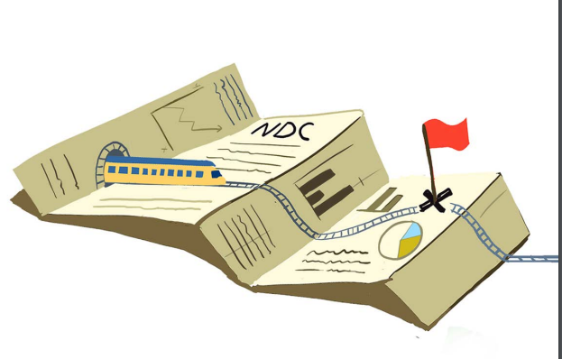
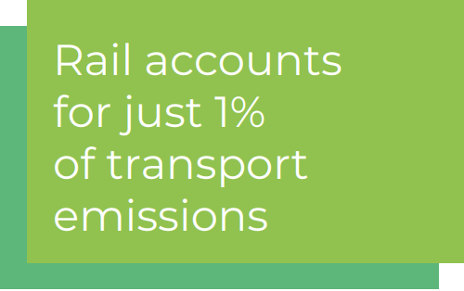
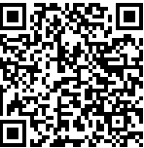
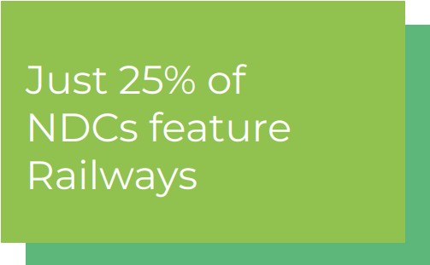
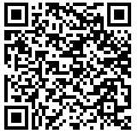
Our 2023 Rail in NDCs Analysis
NDC Analysis
NDC Template
Notes:
Global CO2 Emissions: In 2022, transport sector emissions reached nearly 8Gt CO2, over a third of end-use sector emissions.
Net Zero Emissions Goal: To meet this goal, transport emissions need to drop by 25% by 2030, despite expected demand growth.
Role of Rail: Rail, which currently accounts for 1% of transport emissions but 7% of passenger-kms and 6% of tonne-kms, can significantly reduce transport emissions.
Government Efforts Needed: Increasing rail’s modal share requires coordinated government action through Nationally Determined Contributions (NDCs).
NDC Analysis: Only 25% of NDCs mention rail as a climate solution, and just 10% have specific targets.
Commitments: Countries mentioning rail focus on network expansion, modal shift targets, and electrification.
Challenges: Few countries detail financing or monitoring plans for rail projects.
Recommendations: Enhance rail measures in NDCs and improve international cooperation.
UIC Initiatives: UIC, UITP, and Walk21 are developing a shared template and capacity-building program for better NDCs in active travel and public transport.

Slide 39
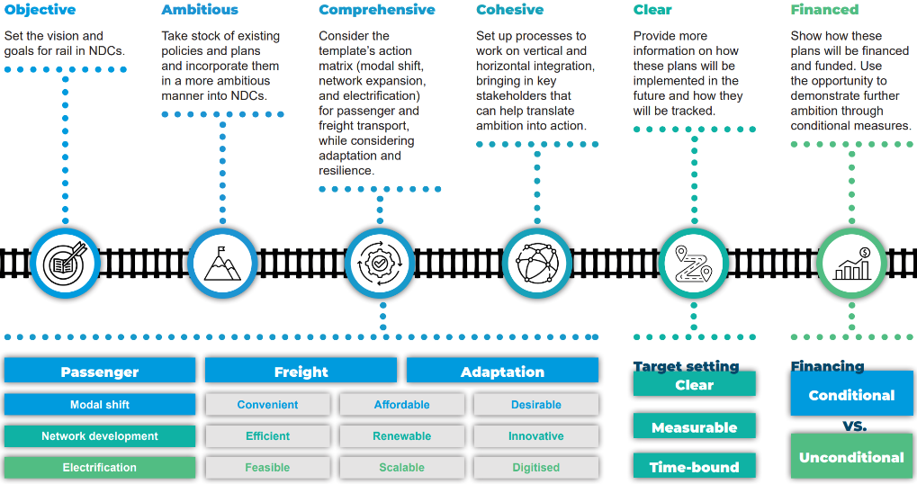
2024 NDC template

Slide 40
WATCH NOW

Slide 41
Collecting messages
Facilitated by:
Ms. Andrea Palma & Ms. Rabea Schmecht
Technical Advisor & Transport and Climate Change Advisor
GIZ

Slide 42
Closing of the day
Ms. Andrea Palma
Technical Advisor, GIZ

Slide 43
Thank you!

