Slide 1

Transport and Climate Change Week 2024
The implementation of an MRV system for Land Transport in Morocco
Methodology & Results
Presented by: Karim Ben Amara
Head of Sustainable Mobility Service – Road Transport Directorate | Ministry of Transport and Logistics
08 November 2024 | Rabat

Slide 2





BACKGROUND : WHY AN MRV SYSTEM ?
Lack of accurate data and indicators on vehicle activity, energy footprint by transport sector, GHG emissions from land transport and their breakdown by sector...
Complexity in identifying mitigation niches, designing and evaluating mitigation measures and improving energy efficiency…
Measures and projects adopted without any assessment of their impact on energy consumption and GHG emissions.
Ensure the effectiveness of investments in this area
1
2
3
4
Meet transparency requirements regarding the Kingdom’s commitments
Identifying niches for mitigating and improving EE
Prioritising and targeting actions
Better design, plan and implement actions
Assess and Adjust
Improve credibility with (green) donors

Slide 3


APPROACHES TO GHG CALCULATION
Top-down
Based on national energy consumption
Emission Factor
(gCO2/litre)
(gCO2/TJ)
GHG Emissions
(CO₂)
Fuel
Consumption
Bottom-up
Based on detailed data on transport activities
Average
travelled Distance
(km/an)
Fuel Consumption (litre/100km)
Number of vehicles
Emission Factor
(CO₂/ litre)
GHG Emissions
(CO₂)

Slide 4






METHODOLOGY ADOPTED
Integration & Sustainability
Governance
Data collection
Analysis & Inventary
Data process
Setting-up of the working group; consultation of stakeholders
Identification of sources and data collection (fleets, mileage, etc…)
Programming of database processing code
« Bottom-up » analysis of activity data and GHG emissions
Integration with existing systems and input into official communications
01
02
03
04
05

Slide 5





METHODOLOGY ADOPTED : STEP 1
Intégration & pérennisation
Collecte
des données
Traitement des données
Analyse & Inventaire
Governance
Setting-up of a working group; stakeholder consultation
Identification des sources, et collecte des données (flottes, kilométrages,…)
Programmation d‘un code pour le traitement des bases de données
Analyse des données d’activités et des émissions GES « bottom-up»
Intégration dans les systèmes acuels et alimentation des communications officielles
01
02
03
04
05

Slide 6



PROJECT TEAM
PARTIE CONCERNEE & COMITE CONSULTATIF
Ministry of Interior (DGCT);
Ministry of Equipment and Water (CNER);
Ministry of Energy Transition and Sustainable Development;
Mohammed VI Fondation for Environnemental Protection;
National Railways Office (ONCF);
National Transport and Logistics Company (SNTL);
Association of Vehicles Importers in Morocco (AIVAM)
Ben Amara Karim
Benniss Fairouz
Medrari Hicham
Zemani EL Mustapha
Khatiri Fatima
ElMir Oussama
Naciri Ikram
Flues Verena
Anne Sophie Tobar-Malagueno

Slide 7

METHODOLOGY ADOPTED: STEP 2
Intégration & pérennisation
Traitement des données
Analyse & Inventaire
Gouvernance
Data collection
Formation du groupe de travail; consultation des acteurs
Identification of sources and data collection (fleets, mileage, etc…)
Programmation d‘un code pour le traitement des bases de données
Analyse des données d’activités et des émissions GES « bottom-up»
Intégration dans les systèmes acuels et alimentation des communications officielles
01
02
03
04
05

Slide 8








DATA COLLECTION

Slide 9
DATA COLLECTION
12
million
+6
million
160 000
Periodic technical inspections of vehicles over 5 years
Registrations and identifications
Technical inspections for 2/3-wheeler
Type, use, Gross vehicle weight, number of seats,
Date of technical inspections and mileage on the odometer
Type of fuel
Registration date
And circulation date
Categorization of vehicles in categories M1, M2, M3, N1. etc.
Average annual mileage by vehicle class and active vehicles
Breakdown of kilometres by fuel type
Average age by vehicle category

Slide 10
METHODOLOGY ADOPTED : STEP 3
Intégration & pérennisation
Collecte
des données
Analyse & Inventaire
Gouvernance
Data processing
Formation du groupe de travail; consultation des acteurs
Identification des sources, et collecte des données (flottes, kilométrages,…)
Programming of database processing code
Analyse des données d’activités et des émissions GES « bottom-up»
Intégration dans les systèmes acuels et alimentation des communications officielles
01
02
03
04
05

Slide 11
DATA PROCESSING
2
4
1st analysis
Active fleet
The initial database includes multiple uses and types of vehicles translated by the Technical WG into 10 official categories (BO)
Plausibilisation and first general analysis of databases (registration, technical inspection, state vehicles, etc.)
Database cleanup:
Correction of input errors,
Format alignment
Determination of the actual number of motorized road vehicles actually running in Morocco:
Who passed the periodic technical inspection + less than 5 years old
1
Cleaning
3
Catégorisation

Slide 12
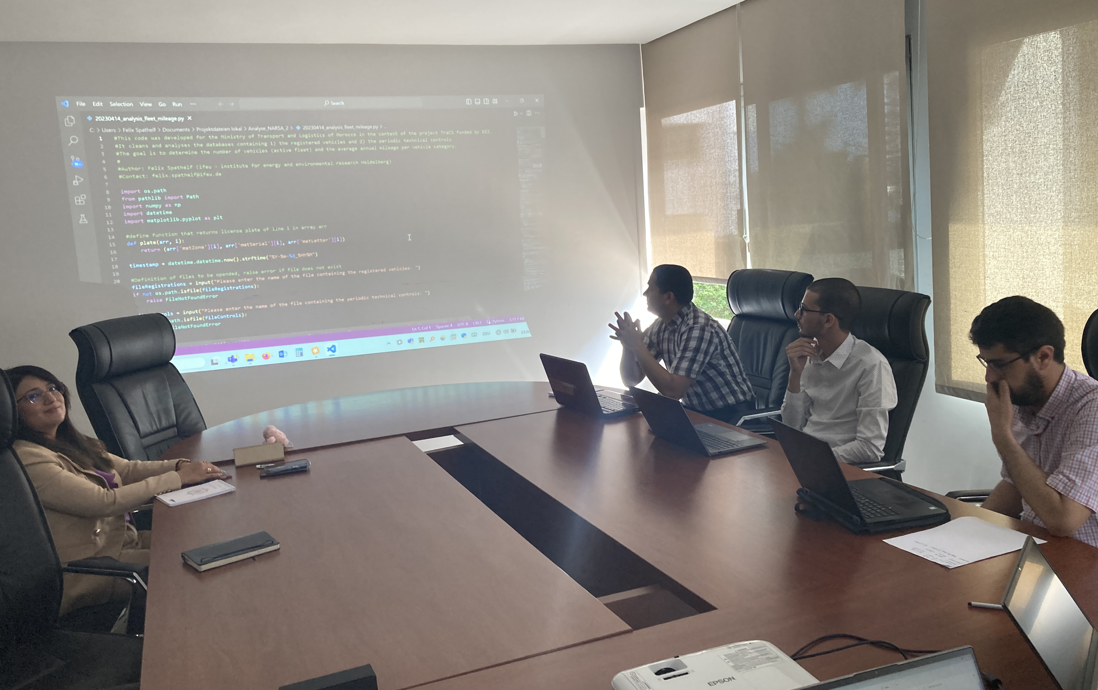
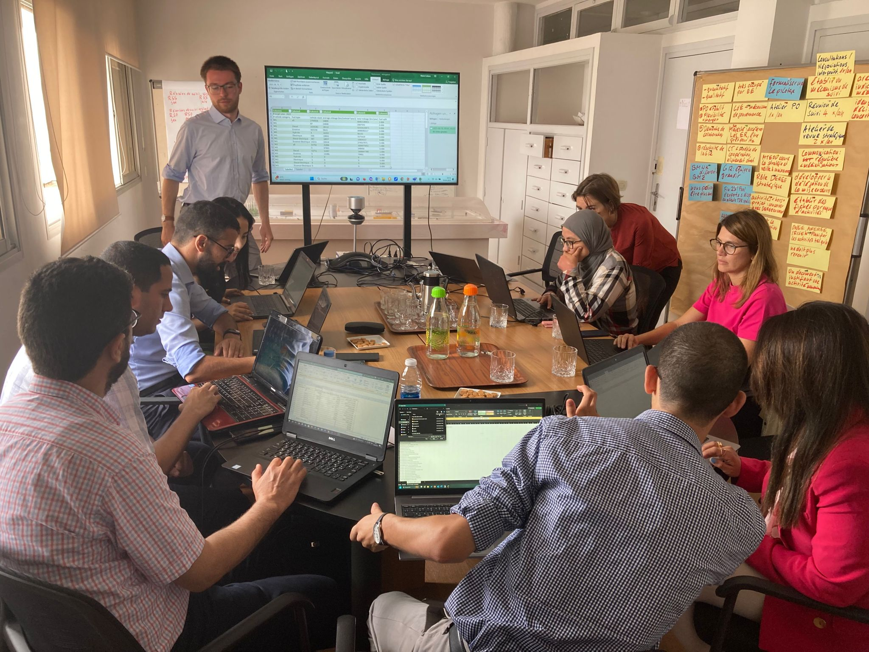
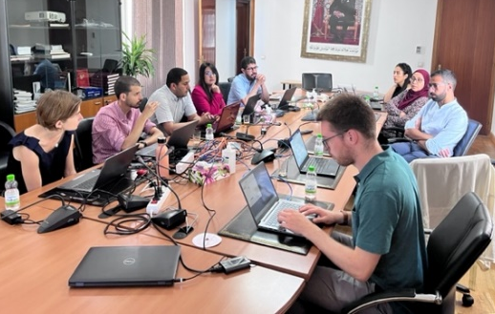
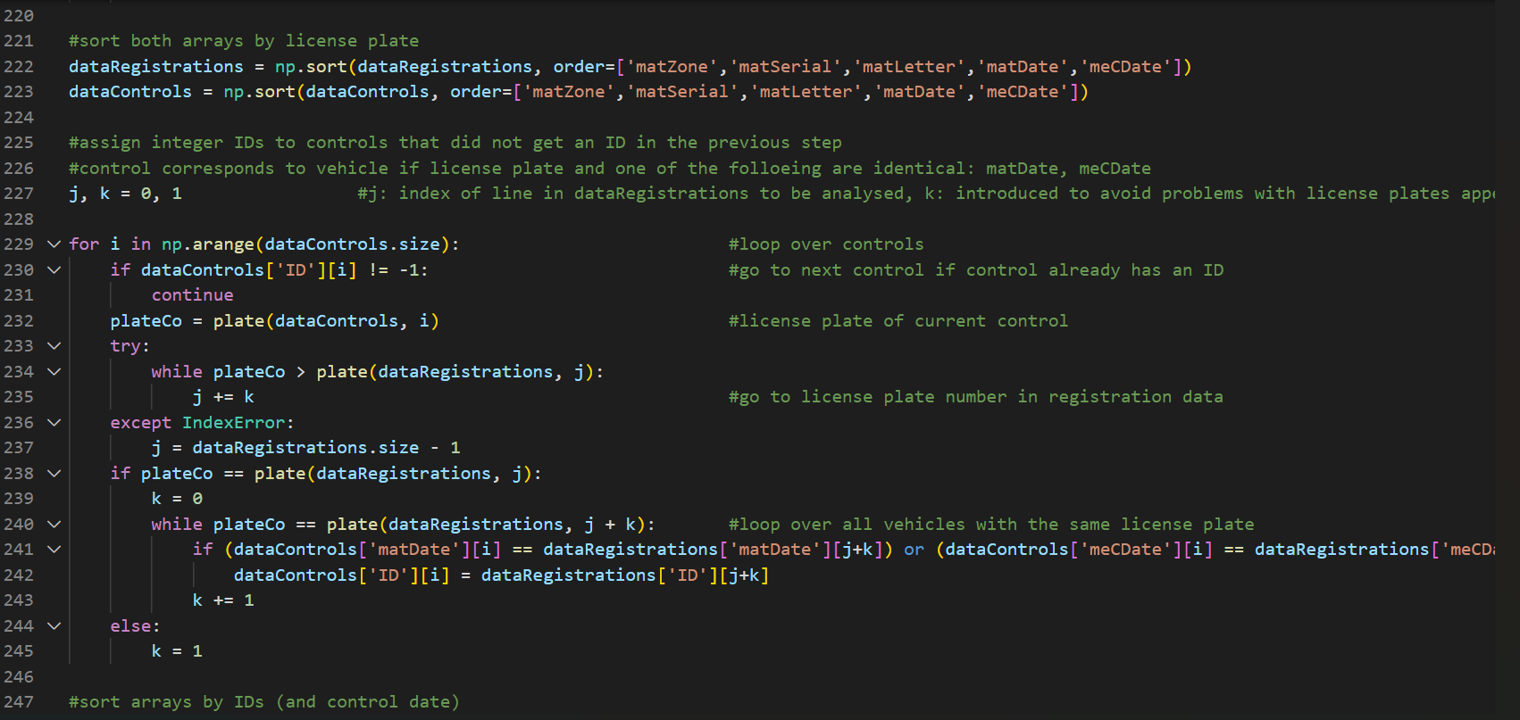
DATA PROCESSING
Algorithm developped by Python to process millions of data (supported by IFEU)
Capacity-building for the team through training sessions in (Data science & big data) using the Python programming language

Slide 13
METHODOLOGY ADOPTED : STEP 4
Intégration & pérennisation
Collecte
des données
Traitement des données
Analysis & Inventory
Gouvernance
Formation du groupe de travail; consultation des acteurs
Identification des sources, et collecte des données (flottes, kilométrages,…)
Programmation d‘un code pour le traitement des bases de données
« Bottom-up » analysis of activity data and GHG emissions
Intégration dans les systèmes acuels et alimentation des communications officielles
01
02
03
04
05

Slide 14
Main results : vehicles fleet in Morocco
 | Registered fleet¹ | Active fleet² | Average age | Kilometres travelled³ | Energy consumption⁴ | GHG Emissions⁵
 | 6.2 M vehicles | 5.4 M vehicles | 13 years | 79 Mds kilometers | 6 212 (1000 TEP) | 19.3 M Tonne CO2eq

Slide 15
Annual mileage travelled by vehicles

Slide 16
GHG Land transport emissions

Slide 17
Carbon footprint by vehicle category

Slide 18
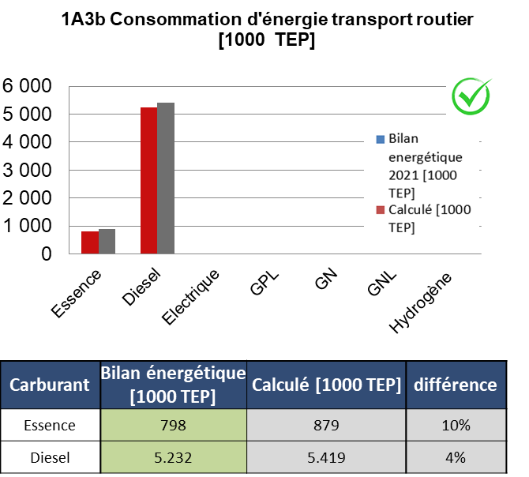

Verification of results
There is some uncertainty in the input data, in particular the average fuel consumption values by vehicle category;
The difference in the results between the energy balance and the inventory carried out is 1% for diesel (the majority of the fleet);
Good validation result through comparison of energy consumption values in road transport;

Slide 19
Main Conclusions & Recommendations
Main conclusions
Motorized land mobility is dominated by private vehicles. The latter accounted for more than half of the sector's GHG emissions in 2022; Two- and three-wheeled motor vehicles accounted for more than 25% of the kilometres travelled by all motorised vehicles (including trains) in 2022; The significant environmental potential of rail transport; Regarding the transport of goods, the largest carbon footprint is that of category (N2) trucks;
Recommendations
The need to rationalise travel and the individual use of motorised private cars (by encouraging carpooling, for example); The modal shift towards micro-mobility and public transport; The modal shift from road freight transport to rail or sea transport; Improving the energy and environmental efficiency of vehicles;

Slide 20
METHODOLOGY ADOPTED : STEP 5
Integration & sustainability
Collecte
des données
Traitement des données
Analyse & Inventaire
Gouvernance
Formation du groupe de travail; consultation des acteurs
Identification des sources, et collecte des données (flottes, kilométrages,…)
Programmation d‘un code pour le traitement des bases de données
Analyse des données d’activités et des émissions GES « bottom-up»
Integration with existing systems and input into official communications
01
02
03
04
05

Slide 21
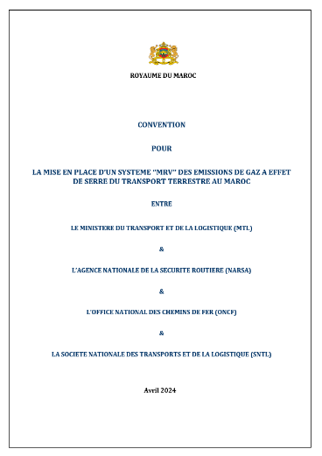
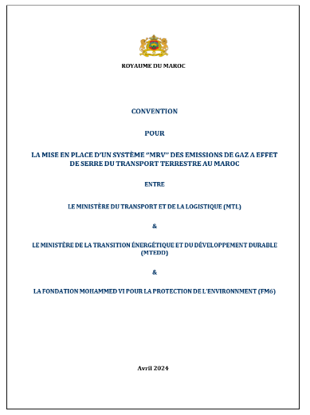
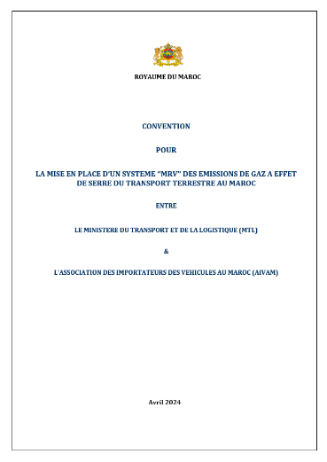
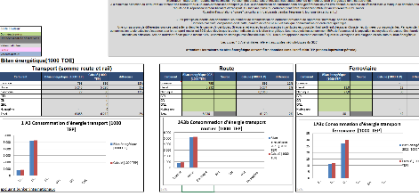
SUSTAINABILITY & IMPROVEMENT
Mise en œuvre des conventions signées aujourd’hui & en tenant la 1ère réunion des instances de gouvernance
Procéder à la réalisation de la deuxième édition de l’Inventaire des émissions des GES du secteur des transports terrestres au titre de l’année 2023 en améliorant certaines données et en produisant d’autres types d’indicateurs (par sous branche de transport / urbain & non-urbain)

Slide 22
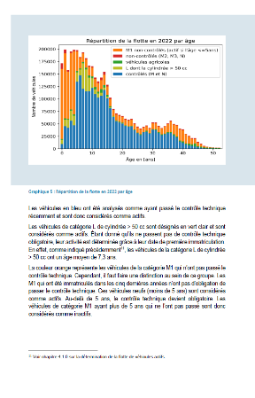
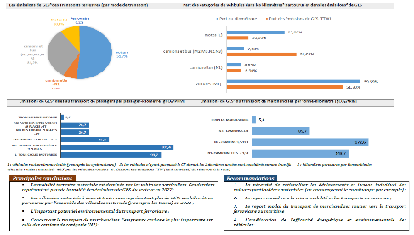
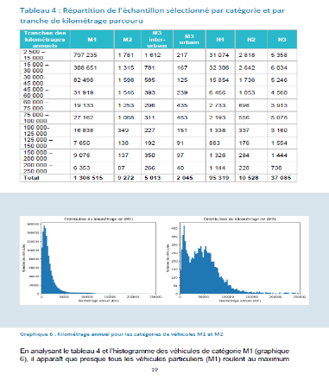

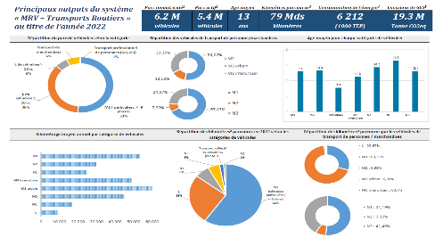
NEXT STEPS
Publication of the final report detailing the methodology, the main findings, the indicators and the recommendations for 2022
Publication of a summary presenting the important results, indicators and recommendations

Slide 23
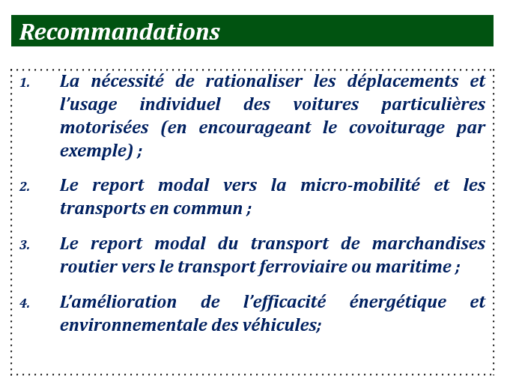
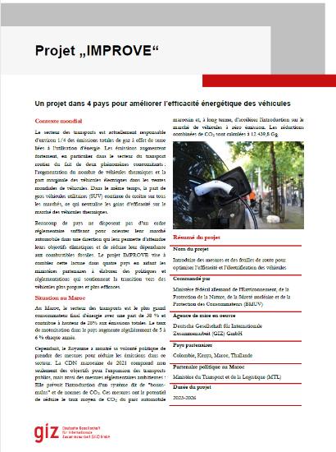
NEXT STEPS
Implement recommendations by adopting the same participatory approach, involving all the parties concerned.
IMPROVE : Introducing Measures, Pathways and Roadmaps for Optimizing Vehicle Efficiency

