Slide 1
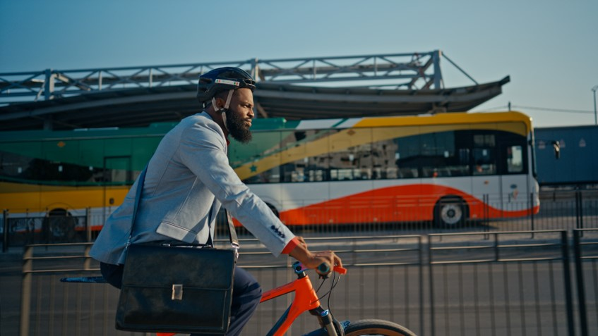

Dakar E-BRT
Proven Solutions for Advancing Sustainable Transport in Africa: No Need to Reinvent the Wheel
Patrick D. DIONE, Transport Engineer

Slide 2

CETUD : 27 years of urban mobility leadership
Transport Organizing Authority in charge of implementing urban mobility policy defined by the Government of Senegal in the regions of Dakar and Thies
Missions :
  Develop sustainable urban mobility strategies
  Modernise urban public transport systems
  Regulate urban public transport
  Manage traffic and parking
  Provide support for urban development

Slide 3
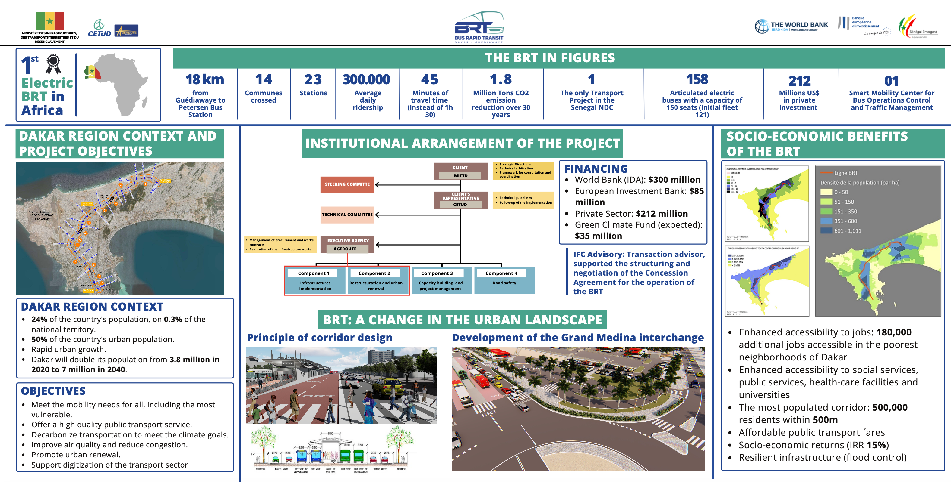
$370 million
Total : $667 million

Slide 4
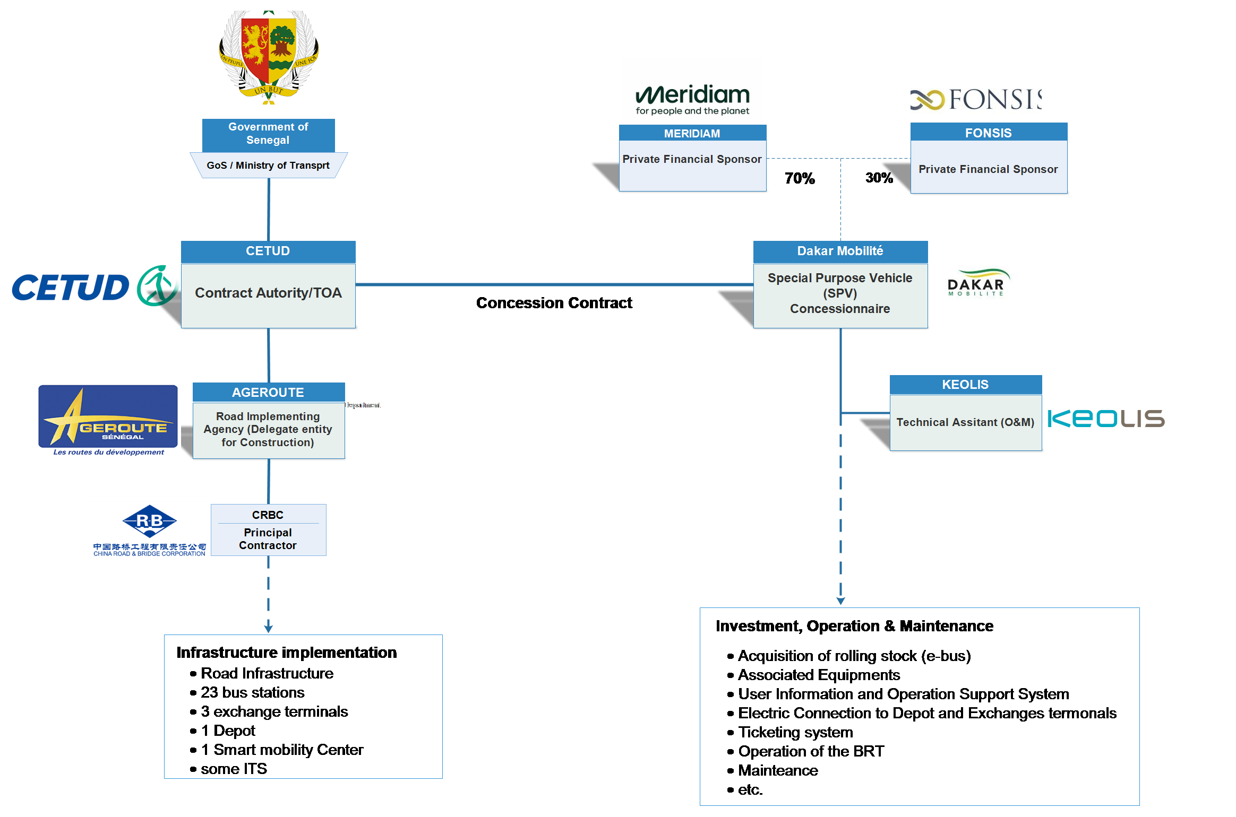
Project Stakeholder Map (PPP)
57%

Slide 5
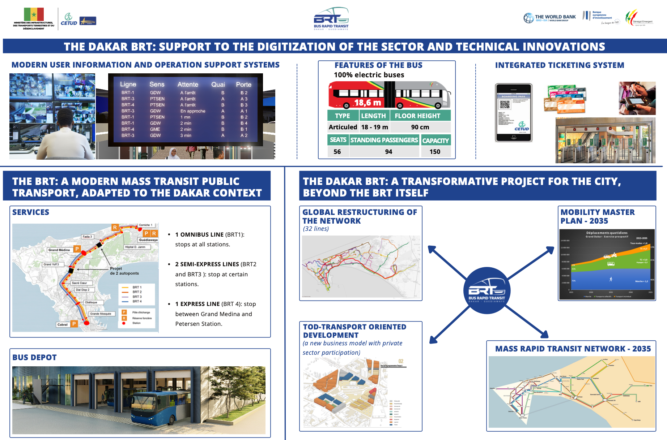

Slide 6
Next steps : Restructured network of urban transport
6
A network of 103 bus lines :
Level 2: 32 priority lines (in terms of investments)
Fare integration with BRT and TER
They will also include feeders on the BRT and the TER
Level 3: 71 classic lines
60 lines operated by AFTU and DDD
no fare integration initially with BRT and TER.
11 new lines created to provide last kilometer service to neighborhoods.
Level 4: Artisanal services
ultimately called upon to join the restructured network (Level 3)
Network Prioritization
Level 1 : Mass Rapid Transit (BRT and TER)
Level 2: Priority bus network
Level 3 : Classic bus network
Level 4 : Artisanal Network
Support for existing public operators (AFTU, DDD) planned throughout the implementation of the new restructured network.

Slide 7
Next steps : Priority Investment Program
    Phase 1 (under implementation 2023 – 2026)
      14 lines
      440 000 passengers/day
      380 buses (standard + midibuses ) CNG
      1 electric pilote line
      2 depôts
      30 km de road
      8 crossroads
      12 bus terminals
      Investment cost : 353 millions € HT

Slide 8
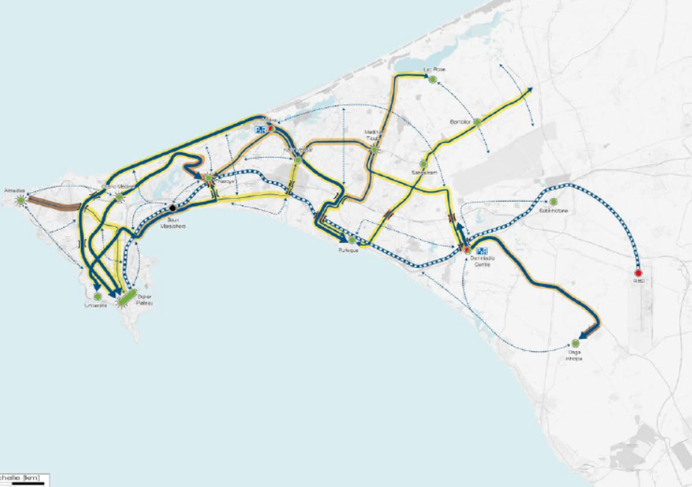




Next steps : Sustainable Urban Mobility Plan
Mass Public Transport
7 new mass transport line
175 km more in 2035
15 multimodal hubs
In addition to the Baux Maraîchers
+ 175 km
75 km on the main network
100 km on the secondary network
2035 MRT network
15% reduction in GHG emissions

Slide 9
www.cetud.sn
Acting for sustainable urban mobility

