Slide 1
Towards Gender
Transformative Transport Systems:
Leveraging networks for action
Notes:
2 min: Introduction of the session facilitator (Andrea)
5 min Introduction of the session (Ari)

Slide 2
The session aims to spotlight why:
Feminist and
gender-transformative urban mobility systems require women as leaders and active participants in planning and policy decisions.
Why are women
under-represented?
How we can increase women’s representation in each stage of the employment lifecycle ?
What are best practices from around the world?

Slide 3
Global Alliance for Feminist Transport​
The first global hub on feminist transport and mobility.

Slide 4
Women in the Transport Workforce
01
Attraction and Recruitment of Women
GIZ Perú / La Rolita
HR Policies and Practices
Women on the Move / SafetiPin
02
03
Leadership and Career Progression
Women Mobilize Women / GIZ Uganda
04
Breakout sessions
What can be done from different stakeholders perspective?

Slide 5
The speakers
La Rolita
SafetiPin
GIZ Uganda
Luis Alejandro Camelo Barragan, Special Program Analyst
Rithvika Rajiv,
Senior Program Associate
Lisa Eva Hofheinz, Project Head

Slide 6
Notes:
The Global Alliance for Feminist Transport connects and empowers organizations, networks and individuals working towards gender-equitable transport systems worldwide. Our shared vision is to act as the leading voice on feminist sustainable transport by providing a spotlight on who, how and what are moving our cities towards greater gender equity in transport and mobility.

Slide 7
Functions of the online hub​
Overview of Organizations and Networks
Community News and Activities
Global Expert Database
Knowledge Hub
Keeping you updated on events, tenders, job offers, and news from the community
Connecting you with women in transport and gender expertise
Compiling the latest data, tools, and good practice
Over 40 organizations dedicated to gender equity in transport

Slide 8
Did you know?
The poll
Notes:
10 min: The Poll (Ari)

Slide 9
Pillar
1
Women in the Transport Workforce:
Attraction and Recruitment of Women
Luis Alejandro Carmelo Barragan

Slide 10
The objective
Pillar
1
Encouraging women to take up relevant studies and pursue career opportunities in transport and strengthening women’s recruitment, particularly into technical roles.

Slide 11
La Rolita
It is a commitment to an environmentally sustainable system with a focus on gender equity.
50% of bus operators are women, transforming the face of a sector that has historically been male-dominated.

Slide 12
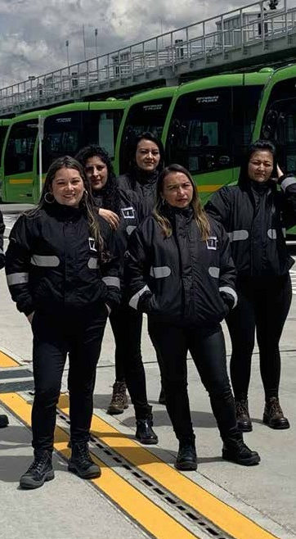
Who are we?
A commitment for gender equity,
with 285 women empowered at the steering wheel of a 100% electric fleet
‘La Rolita’ is created as an operator with
100% electric buses
with a strong commitment to gender equity and sustainability.
We’re the sixth public entity of Mobility Sector in Bogotá.

Slide 13
We are committed to 2030 Sustainable Development Goals (SDGs).

Slide 14
285 women
In 2 years of operation, we have generated close to
45%
MEN
700
55%
WOMEN
Formal green jobs
- Total company -
currently drive/operate the buses, most of whom are mothers and heads of households.
This is 62% of the total number of drivers/operators.

Slide 15
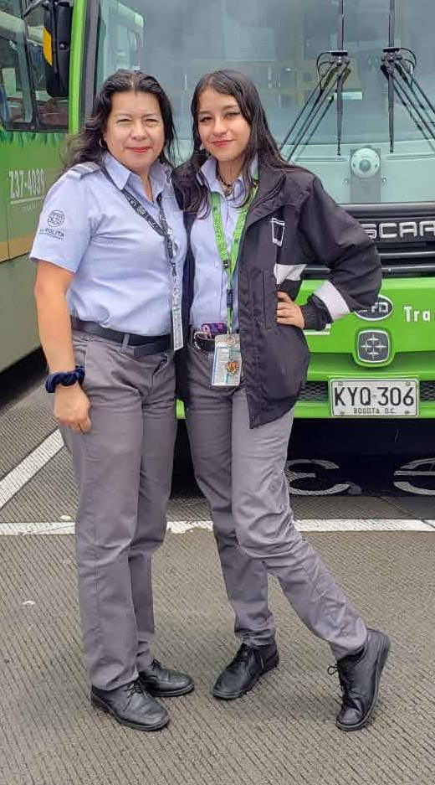
Mothers and daughters, fathers and sons, members of the LGBTIQ+ community, and foreigners living in the area, among others, work at 'La Rolita'.
We also generate indirect employment for families living in the area of influence.
We’re a welcoming, equitable and inclusive company.

Slide 16
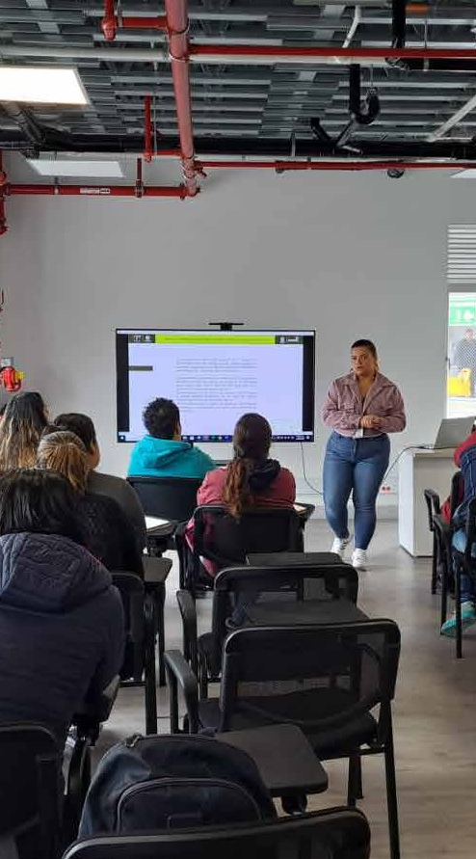
Challenges in education, training and skills development
1
Professionalizing driving
Women and men operators have in-depth knowledge of the electrical operation of the vehicles to optimize use and recycling of energy, they take ownership of Road Safety and develop skills for an efficient service to users.
2
Appropriate and take advantage of technology
Connected communication systems to produce data analytics that qualify driving and optimize response times, demanding new profiles and skills in workers.
3
Strengthening maintenance knowledge
Development of new skills in maintenance personnel on new technologies for electric buses, such as charging systems, regeneration, battery management and disposal, among others.
We work with the SENA (National Learning Service), the 'Cajas de Compensación Familiar' (organizations in charge of providing supplementary benefits in addition to mandatory employment benefits), specialized companies and suppliers to increase the hours of training and incentives for our employees.

Slide 17
Each 'La Rolita' electric bus is equivalent to CO2 reduction of what 2,300 planted trees purify.
2Millions tons
We have avoided the emission of
of
into the environment
We provide a quality, clean, friendly and efficient service.
We transport more than
per day in a fleet of
53.000 people
195 full-electric buses.

Slide 18
We promote with our workers and the surrounding communities the care of the environment and the planting of urban gardens for the production of food for their own consumption.
Together we make it possible

Slide 19
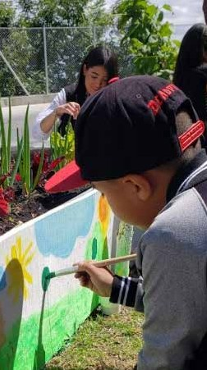
We promote with our workers and the surrounding communities the care of the environment and the planting of urban gardens for the production of food for their own consumption.
Together we make it possible

Slide 20
Pillar
2
Women in the Transport Workforce:
HR Policies and practices
Rithvika Rajiv

Slide 21
Safetipin
A social impact organization working towards Building Responsive, Inclusive, Safe and Equitable Urban Systems. We collaborate with government and non-government stakeholders in using big data to improve infrastructure and services in cities.

Slide 22
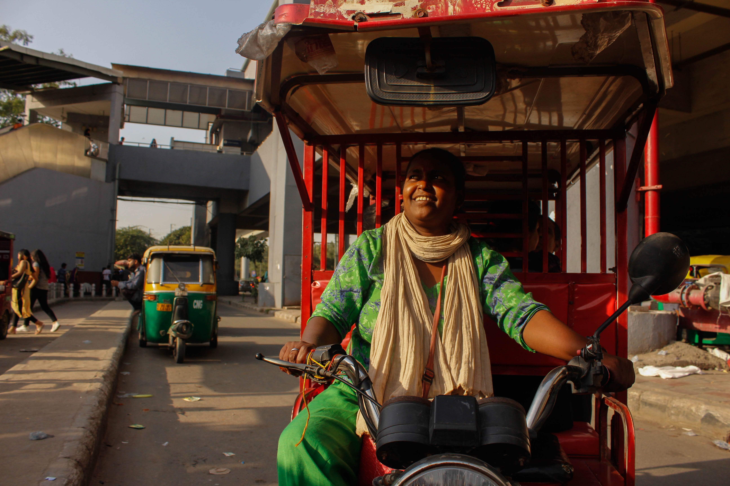
Women in Transport
17%
Women in the transport workforce globally
(ITF, 2024)
Notes:
but let´s zoom out and look at the big picture
the market shows promising numbers.
In comparison to all other mobility solutions, the bicycle has gain an upward trend within Germany.
Today 15% of trips are done with bikes.
And the German Cyclists Association expects this number to double in the next 5 years in urban centers.
Just again singals of a developing and existent market show that it is far from being dead, to the contrary.. people are adopting the bicycle more and more in Germany.
And the trend within that category is electrification - not just with cars also with bicycles.
A Deloitte study concluded that e bikes were sold 3 TIMES MORE than electric cars.
And furthermore this last year for the first time ebikes sales surpassed traditional bikes.
This all leads to a promising market of 12.5 billion dollars alone in Germany by 2029.
Big numbers today and big numbers to conquer in the future.

Slide 23
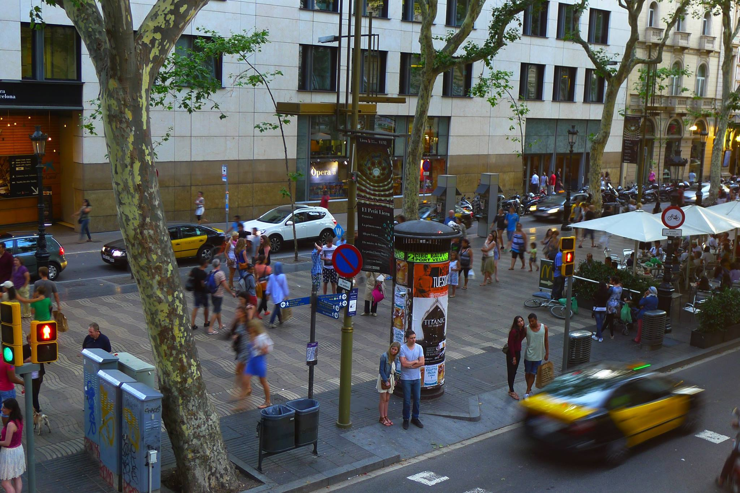
There is an all-pervasive unconscious bias against women in transport

Slide 24
The
Challenges?
Safety and gender-based violence
Male dominated sector
Time poverty
Poor infrastructure & working conditions
Lack of necessary skills- technical and soft

Slide 25
The objective
Pillar
2
Ensuring that HR policies and practices support equal opportunity and provide for inclusive working environments that correspond to the needs of women and men alike.

Slide 26
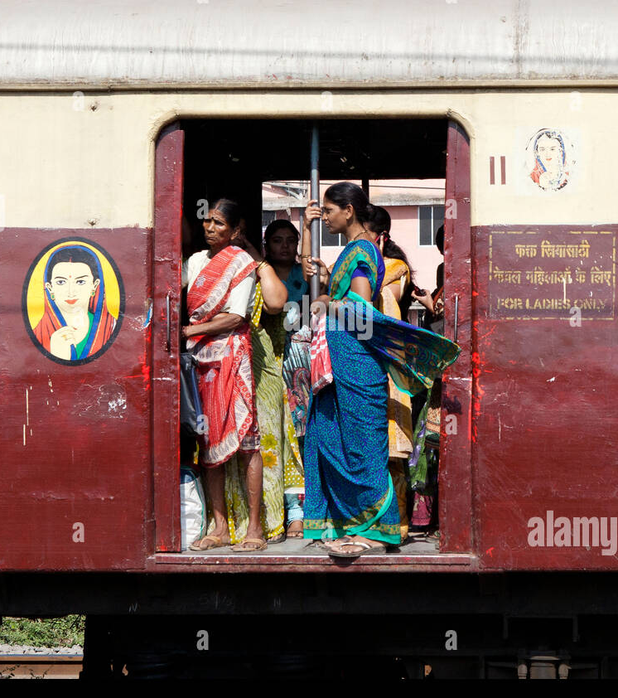
Good policies
and
practices
There is an all-pervasive unconscious bias against women in transport

Slide 27
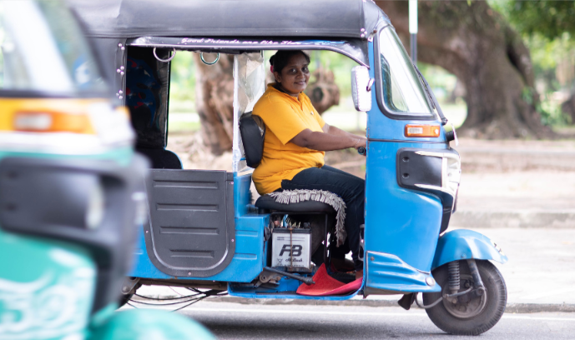
Measures for women's safety
What could this look like?
Comprehensive and actively implemented support systems
Strong action against perpetrators
There is an all-pervasive unconscious bias against women in transport
Safety first approach
(IFC, 2020)
For women drivers on ride hailing platforms, this can also include initatives such as gender segregated rides and safety measures such as dividers

Slide 28
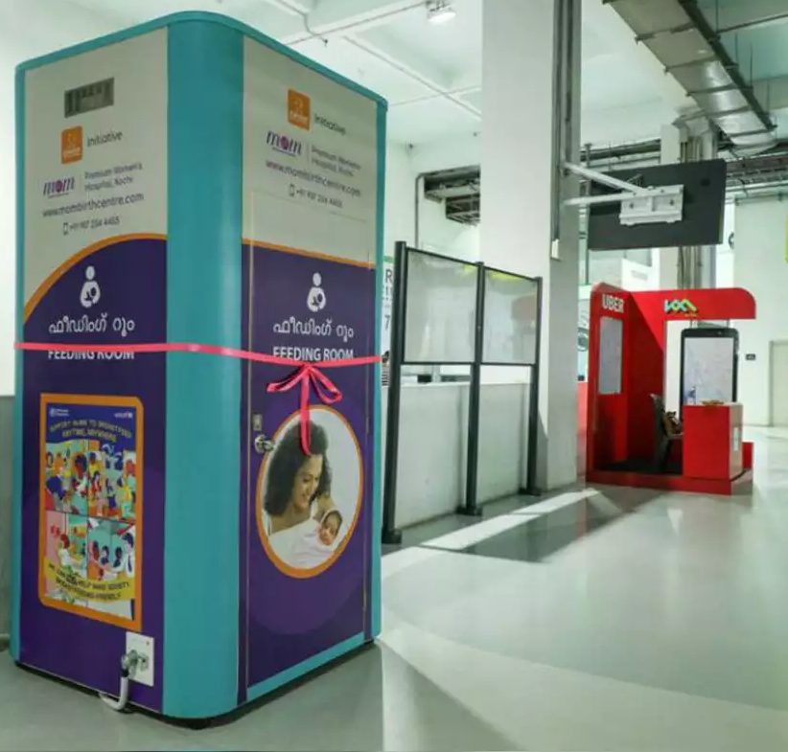
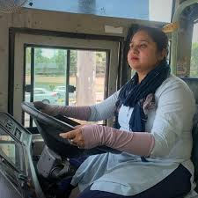
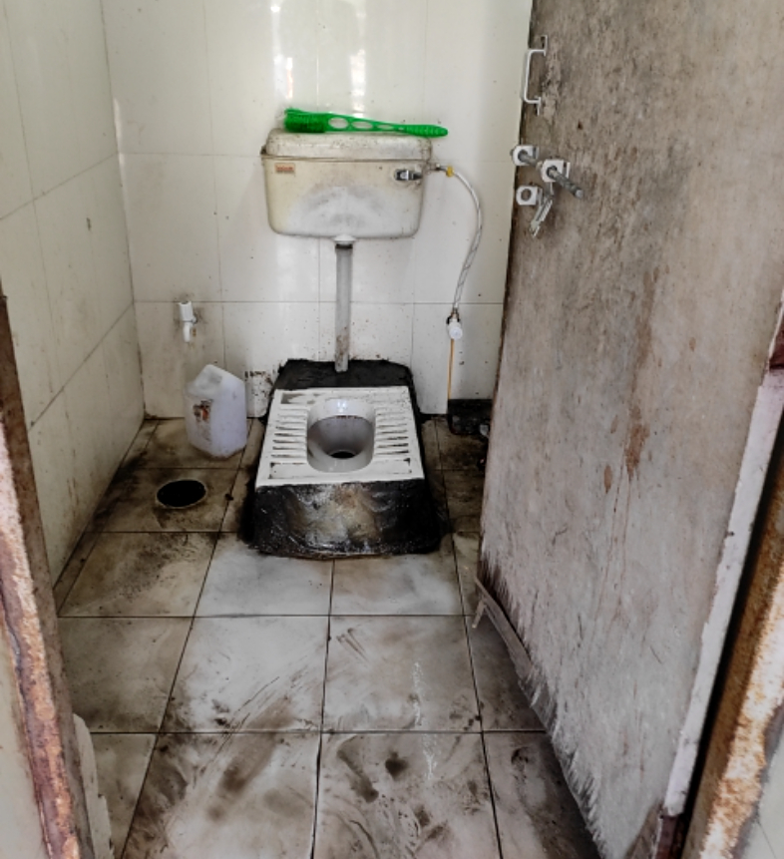
We need dedicated ladies' restroom at depots and terminals. We get 30 mins break for lunch and rest, but if there is no place in the terminal to actually rest what is the point of getting a break? Even if we are resting in the bus, we can not be sure of our safety as anyone can forcibly enter the bus and we don’t feel safe.
- Women bus conductors
Gender responsive infrastructure- eg; sanitation, rest, creches etc
There is an all-pervasive unconscious bias against women in transport
(Times of India 2019)
(Azad Foundation, 2023)
(Safetipin, 2023)

Slide 29
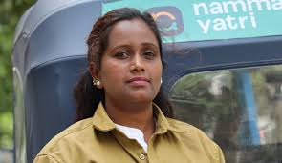
Gender sensitive policies
Inclusive leave policies
Gender responsive technology
There is an all-pervasive unconscious bias against women in transport
Equal opportunity and pay
Gender disaggregated data collection
(NDTV Profit, 2023)

Slide 30
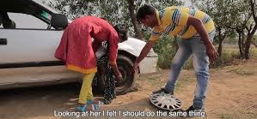
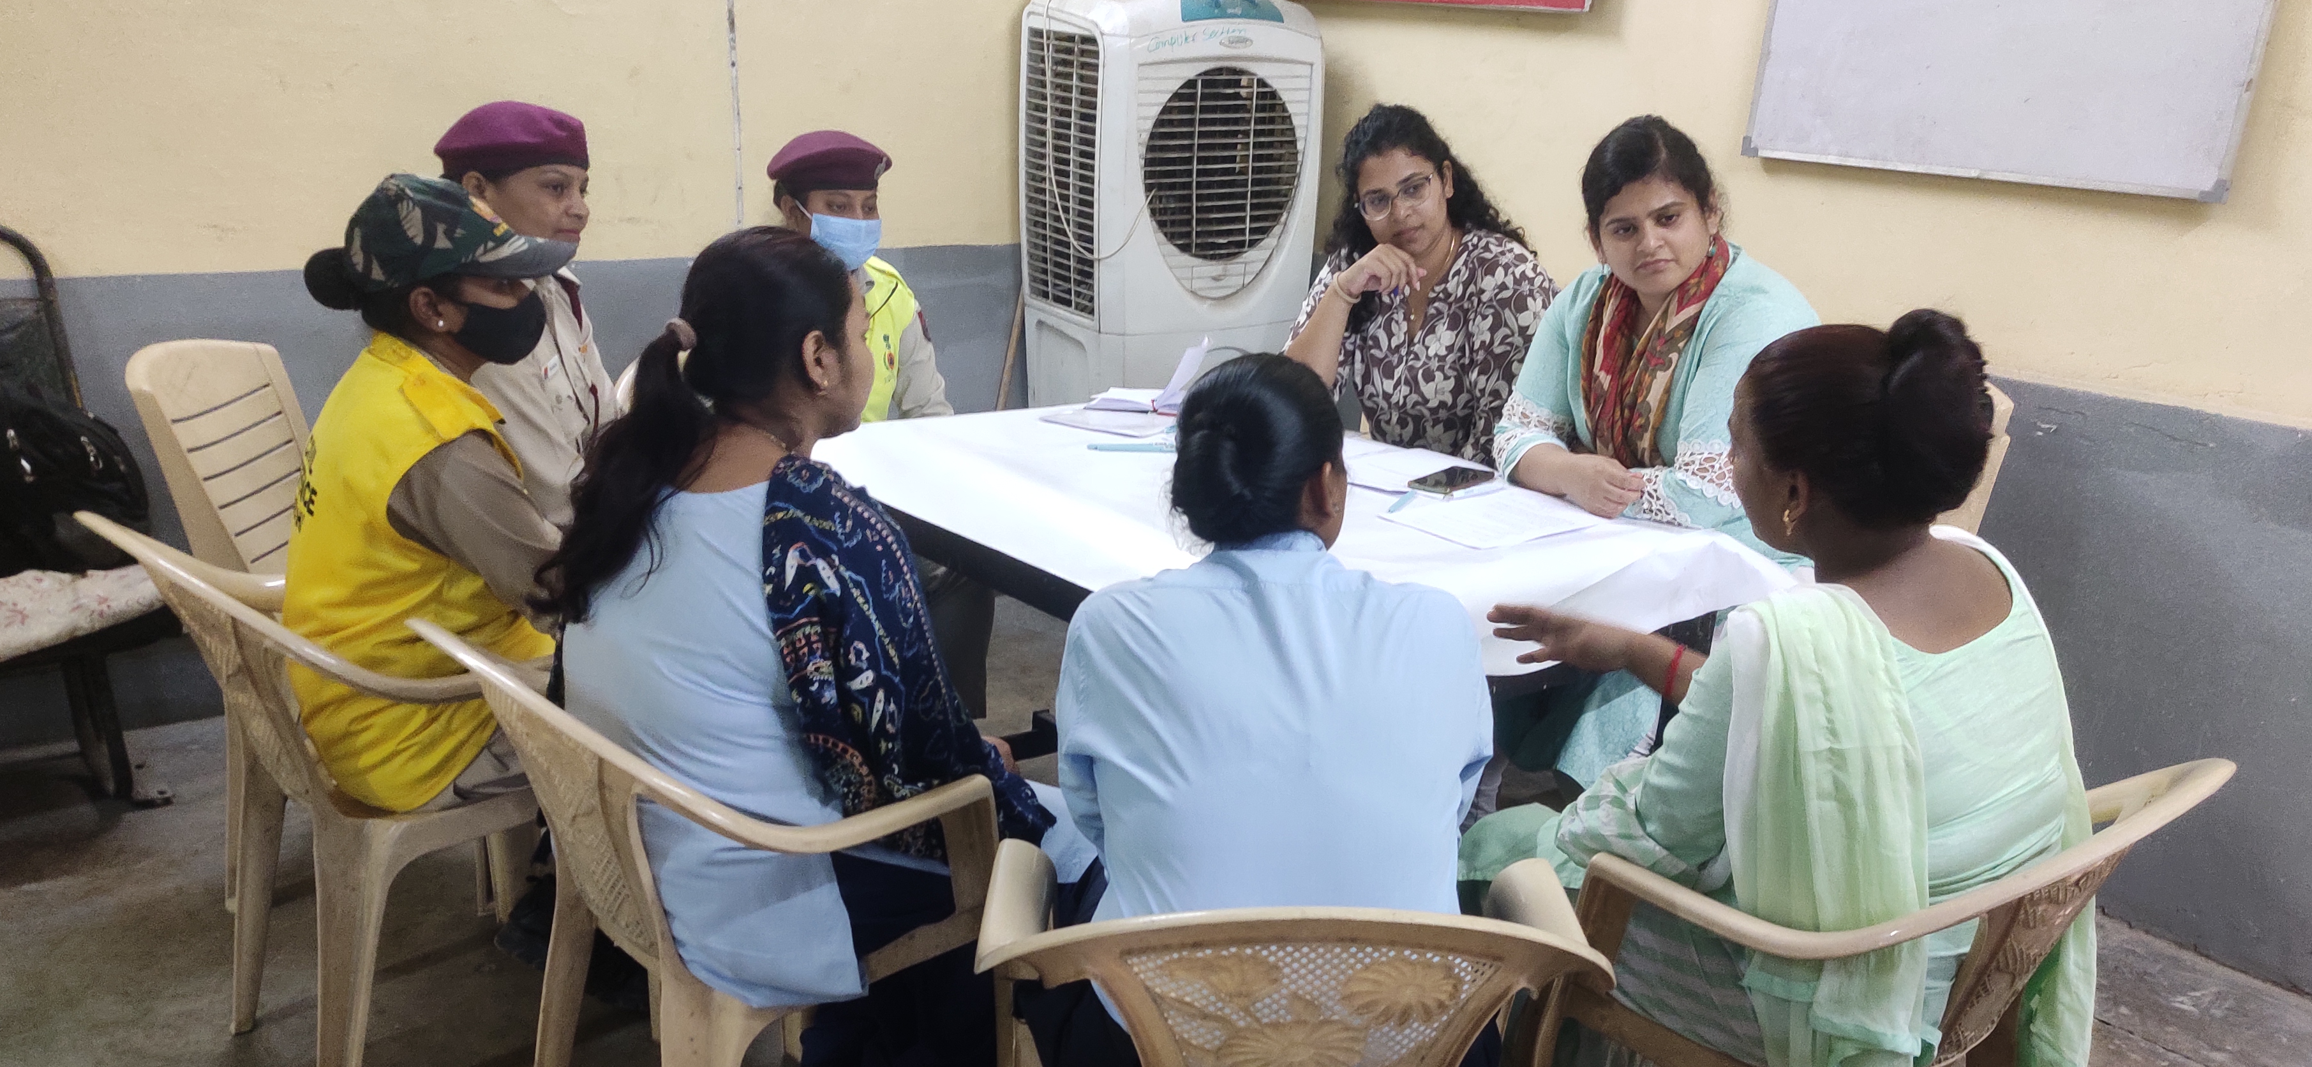
Skill development
Incorporate women voices
There is an all-pervasive unconscious bias against women in transport
(Azad 2020)
(Safetipin, 2023)
Technical skills
Women in decision making
Soft skills- interpersonal skills, conflict resolution and negotiation
Feedback from women can offer valuable insights to shape policies, services, and environments
Self-defense

Slide 31
Code of conduct & guidelines for respondse to sexual harassment
In the absence of laws
Minimum standard of behavior and actions
There is an all-pervasive unconscious bias against women in transport
Training and sensitisation
(Flone Initiative Trust, 2020)

Slide 32
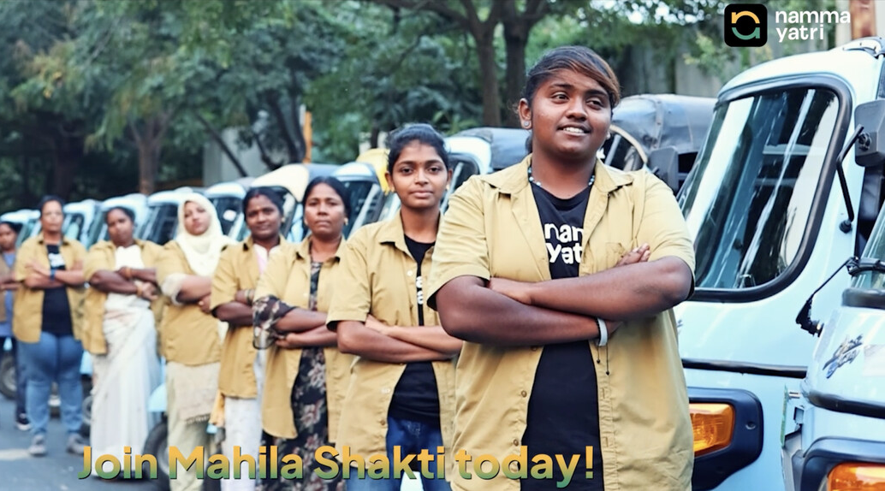
Mentoring, peer to peer support networks
Public awareness campaigns
Personal and professional development
Women in transport database
(Namma Yatri, 2024)
Normalize women in transport

Slide 33
Pillar
3
Women in the Transport Workforce: Leadership and Career Progression
Lisa Hofheinz

Slide 34
The objective
Pillar
3
Supporting women’s leadership and career progression, including in higher-paid technical roles within the industry.

Slide 35
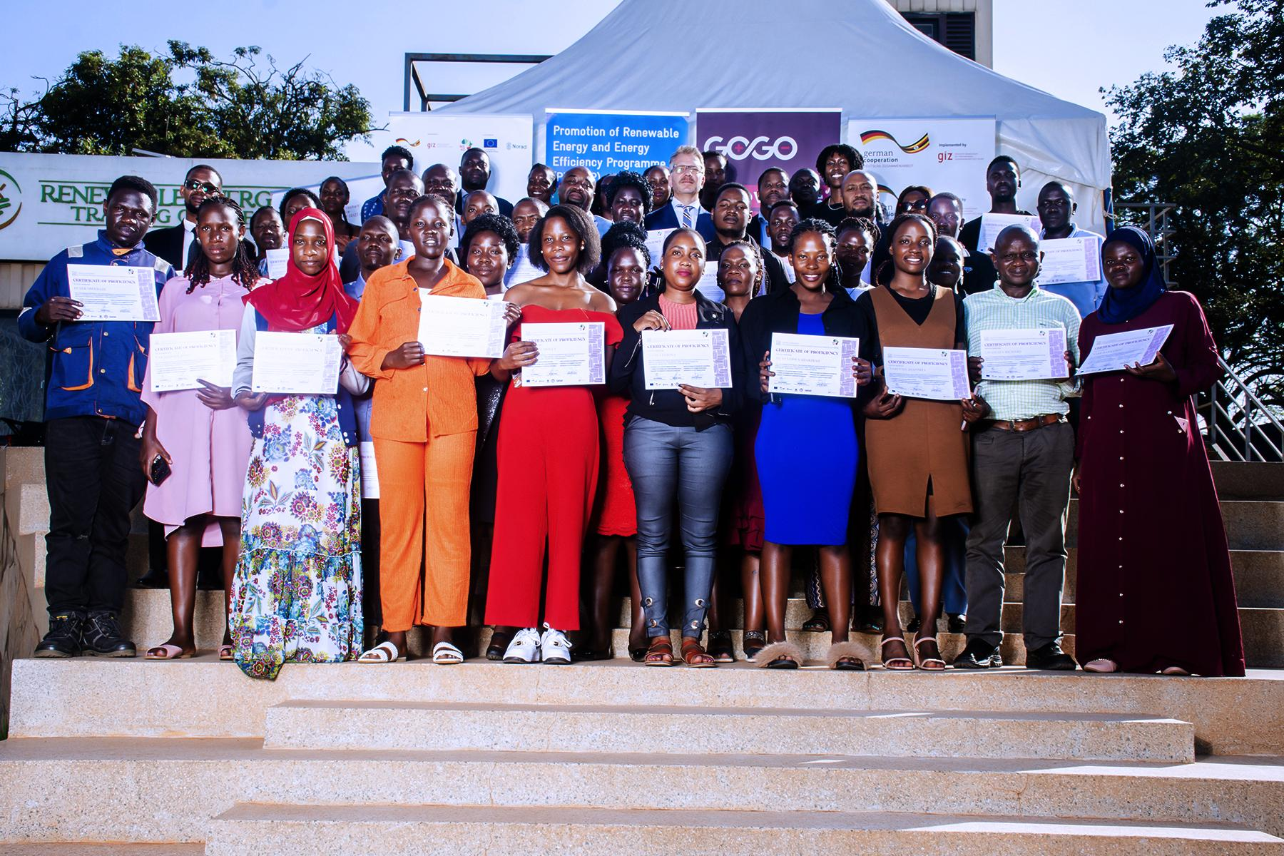
Skilling for e-boda sector
GIZ Uganda rolled out trainings for the e-boda sector in 2022, jointly with GOGO (private sector), in a pilot project.
Currently, the project is in its second phase.

Slide 36
Remain flexible and
Build on successes
In the UG context:
Existing expertise within GIZ UG portfolio (2 projects: technical trainings & employment promotion for women)
Suitable private sector partner and access to political institutions
Flexible project design based on lessons learned,
Strong sector cooperation & momentum,
Change agents as in role models; strong female leaders & male allies

Slide 37
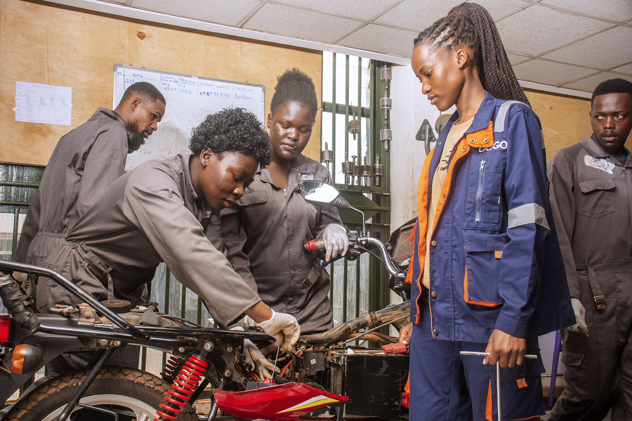
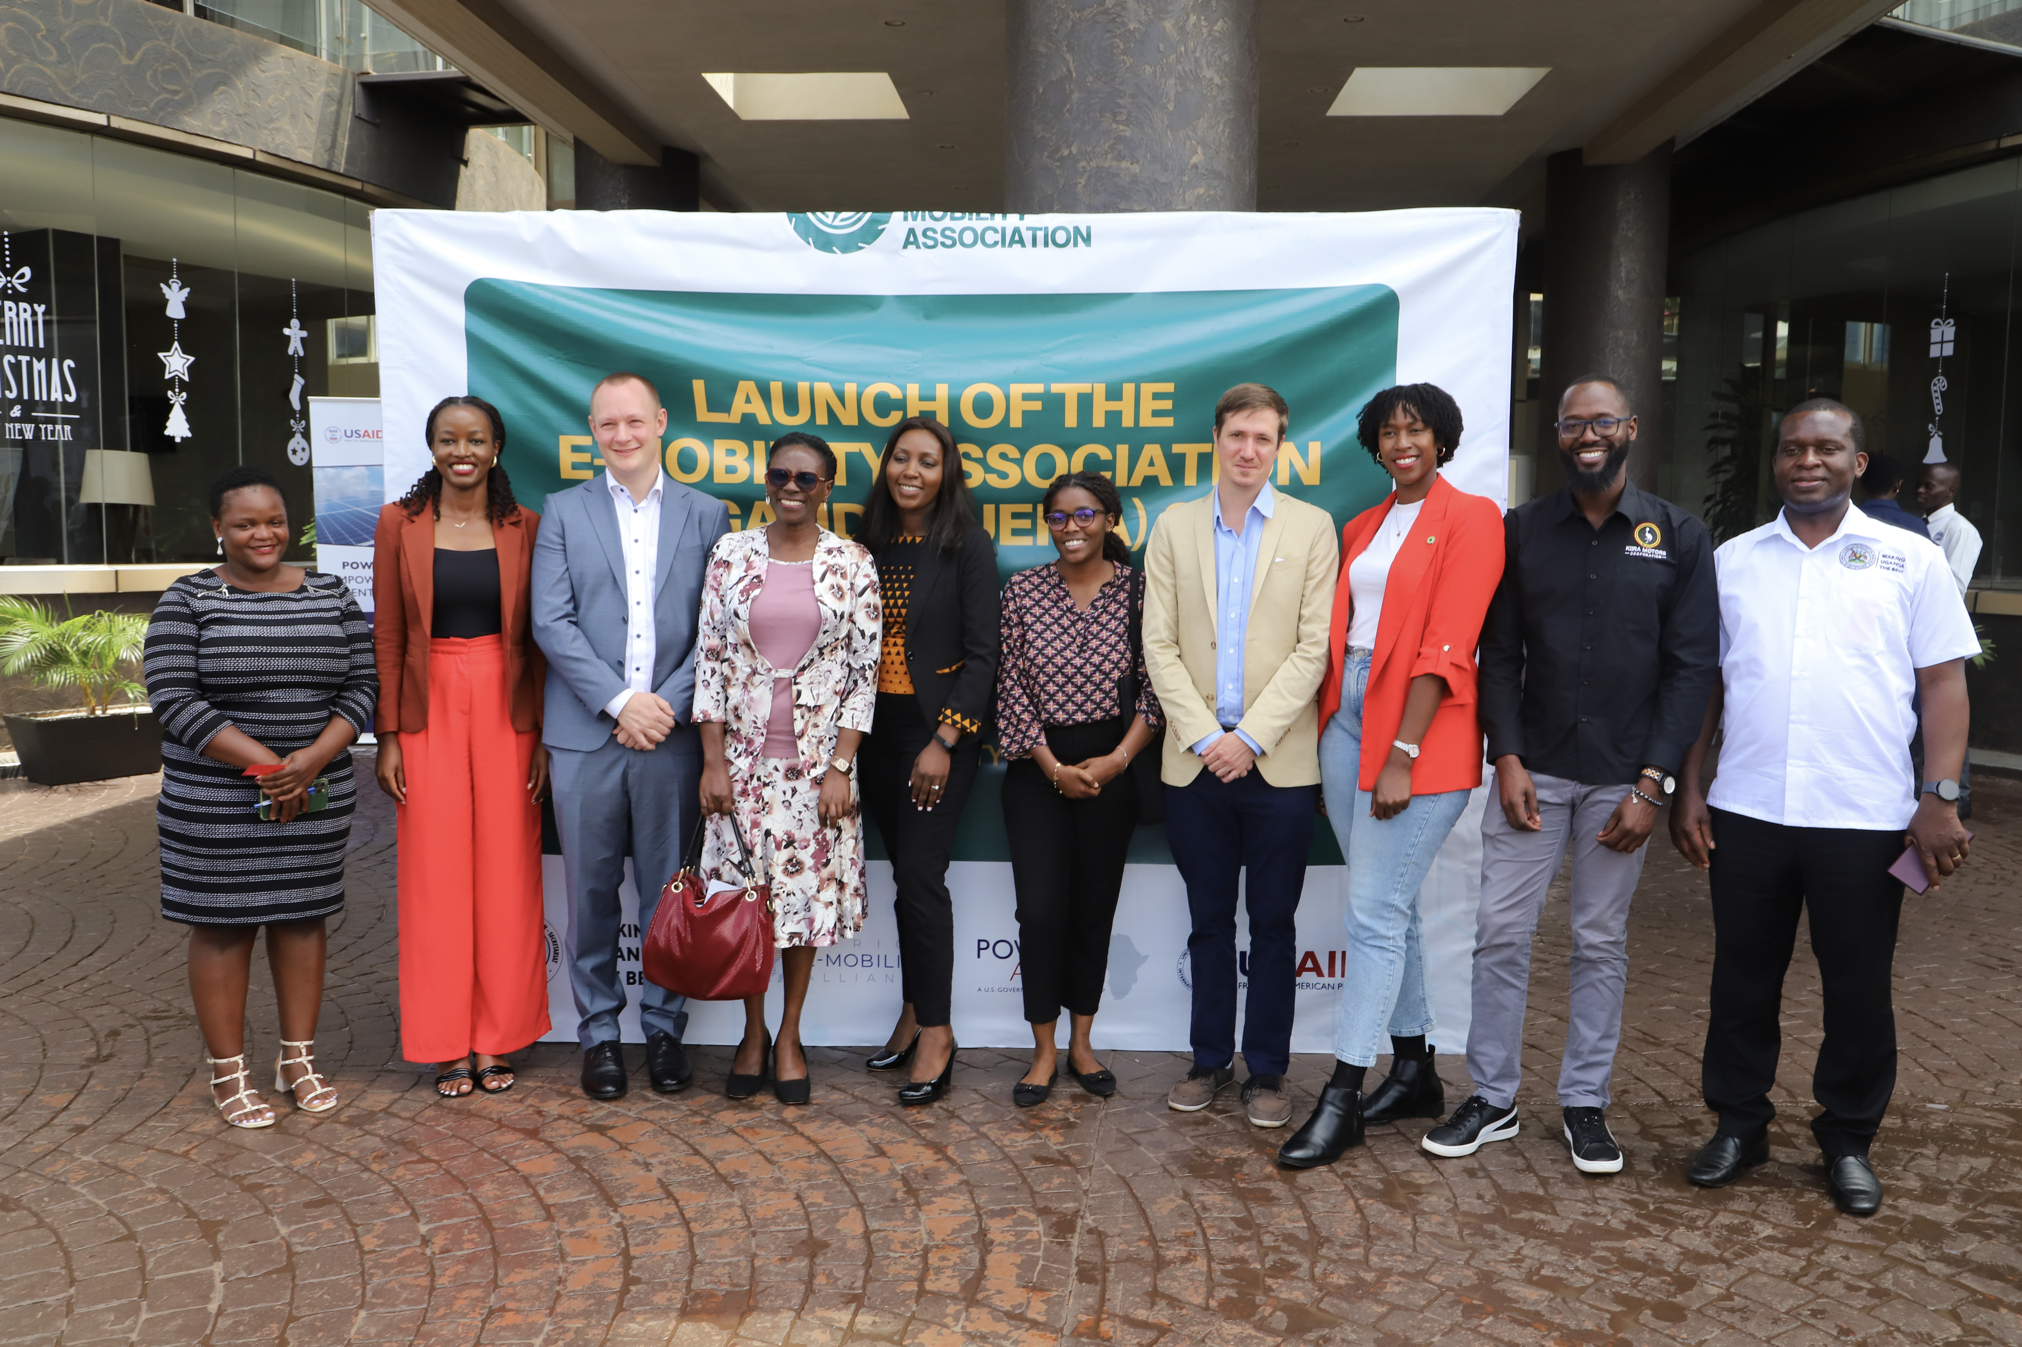
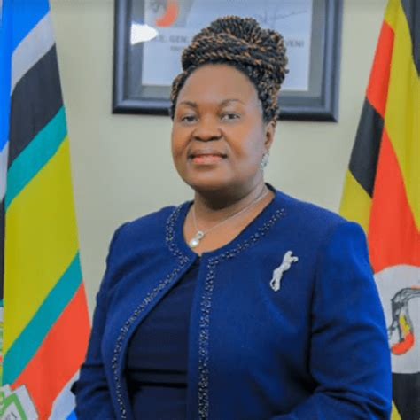
Multi-level approach for conducive environment
Technicians
Managers
Policy makers
Encouragement of participants
Technicians & Operations staff most accepted in cultural context
Role models and gender-sensitive environment are key
Gender-sensitive budgeting for career progression
Access to managerial positions in e-mobility has similar barriers as in other sectors
Sensitization with private sector
Role models
Institutional culture
Sensitization in political institutions
Female leadership as role models
Notes:
but let´s zoom out and look at the big picture
the market shows promising numbers.
In comparison to all other mobility solutions, the bicycle has gain an upward trend within Germany.
Today 15% of trips are done with bikes.
And the German Cyclists Association expects this number to double in the next 5 years in urban centers.
Just again singals of a developing and existent market show that it is far from being dead, to the contrary.. people are adopting the bicycle more and more in Germany.
And the trend within that category is electrification - not just with cars also with bicycles.
A Deloitte study concluded that e bikes were sold 3 TIMES MORE than electric cars.
And furthermore this last year for the first time ebikes sales surpassed traditional bikes.
This all leads to a promising market of 12.5 billion dollars alone in Germany by 2029.
Big numbers today and big numbers to conquer in the future.

Slide 38
Barriers
Male -dominated sector
Structural barriers
Safety concerns for women in technical jobs
Lack of female role models
Sensitization
Budgeting
Strong sector cooperation & change agents

Slide 39
Let's discuss
Pillar
1
Pillar
2
Pillar
3
Attraction and Recruitment of Women
HR Policies and Practices
Leadership and Career Progression
Break-out
Room 1
Break-out
Room 2
Break-out
Room 3
Notes:
10 min: The Poll (Ari)

Slide 40
We are in breakout sessions!
We will be back in a few minutes…

Slide 45
Towards Gender
Transformative Transport Systems:
Leveraging networks for action
Notes:
2 min: Introduction of the session facilitator (Andrea)
5 min Introduction of the session (Ari)

Slide 46
Virtual Meeting Etiquette
Keep your microphone muted unless you are speaking
Raise your hand to speak, you can use the button at the top of your screen
Or use the chat - You can also direct questions and comments here
Turn on your video when talking, we would like to meet you!
Stay present and be respectful. Aim to give your full attention to the session and engage respectfully with others
Ensuring Transport Week remains a safe and inclusive space is important to us. If you experience or witness any inappropriate behaviour or harassment, please report the incident to any member of our overall Transport Week Awareness Team: Keisha Mayuga (keisha.mayuga@giz.de), Anneli Stutz (anneli.stutz@giz.de).
If you face any issues, please contact the Transport Week Team (transportweek@giz.de)

Slide 47
We are in breakout sessions!
We will be back in a few minutes…

Slide 48
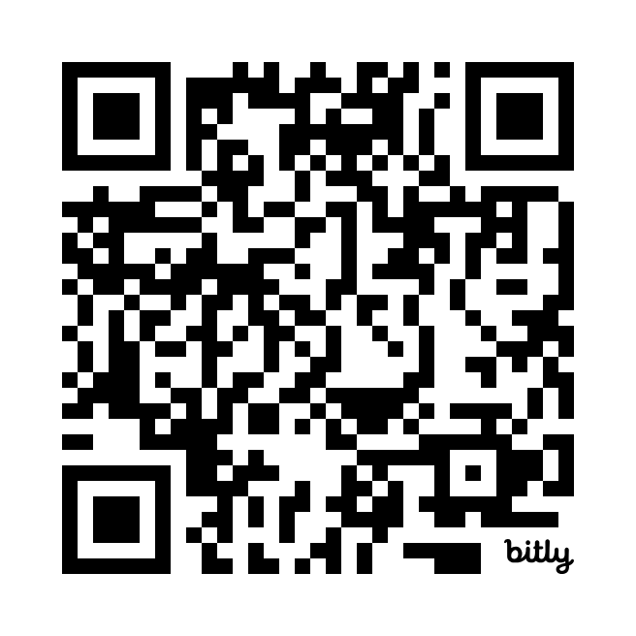
Help us improve!
Share your feedback on #TransportWeek24 in this short survey:

