Slide 1
YUCATÁN TRANSPORTATION AGENCY
Rafael Hernández Kotasek, November 6th 2024.

Slide 2
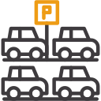
CONTEXT OF THE CITIES
Increased car ownership
Limited transportation alternatives
Stigmatized alternative modes
Suburbanization and degraded cities
Land use planning is car-oriented
Abundant parking availability
Patterns of scattered developments
Car-centric transportation planning
CAR DEPENDENCY CYCLE

Slide 3
PREVIOUS CHALLENGES
Legal Uncertainty
(No incentives for quality)
Uncertainty
No information/data
- Routes
-Distances
-Origin, destination
Public transport as a Political tool
Low integration with other modes of transportation
Lack of expertise on PT/ human capital
Broken financial systems
Lack of sector credibility
Low levels of digitization
Limited infrastructure

Slide 4
INSTITUTIONAL CHALLENGES… IN THAT ORDER
1
2
3
LEGAL CERTA
LEGAL CERTAINTY
FINANCIAL VIABILITY
OPERATIONAL EFFICIENCY

Slide 5
VA Y VEN SYSTEM
Institutional legal certainty
Operational strength
Financial strength
KIND
MODERN
ACCESSIBLE
EFFICIENT
QUALITY VA Y VEN

Slide 6
WHAT IS VA Y VEN SYSTEM?

Slide 7
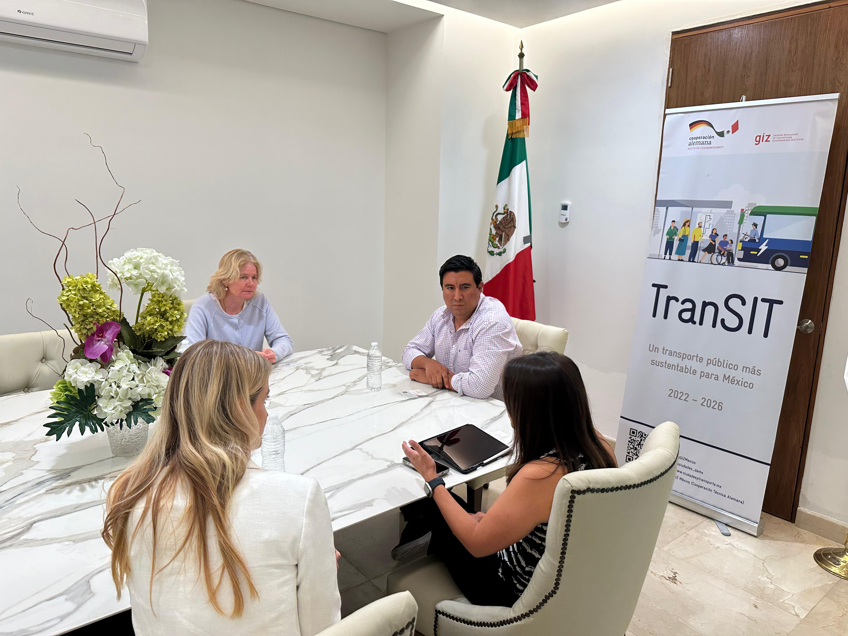
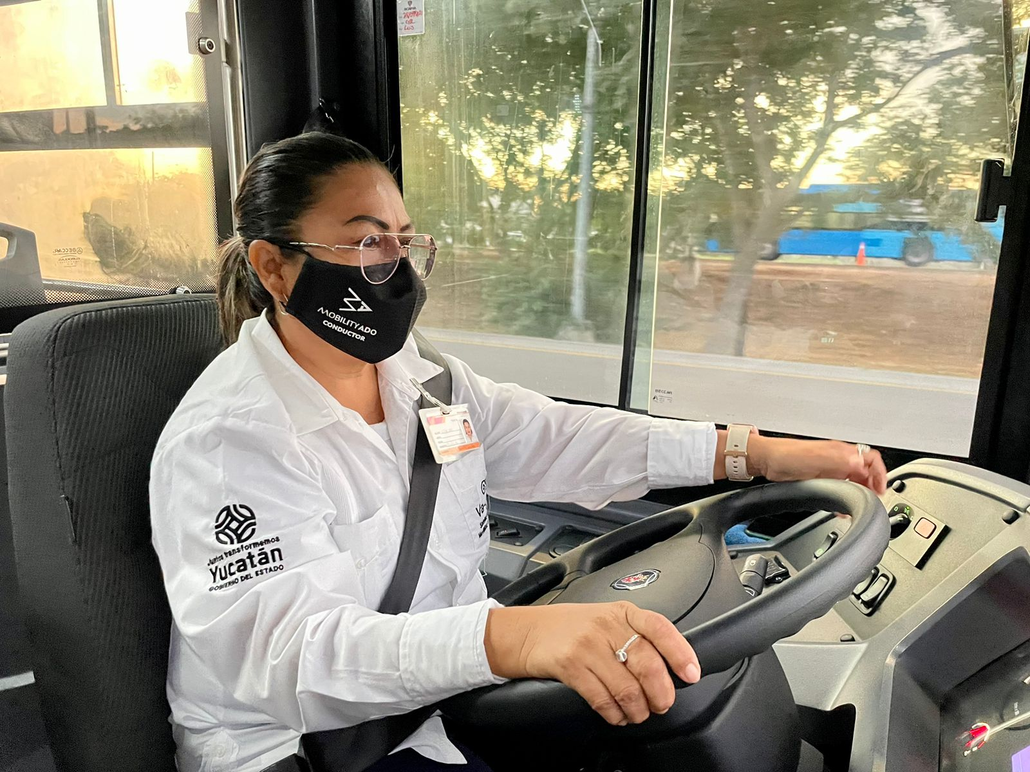
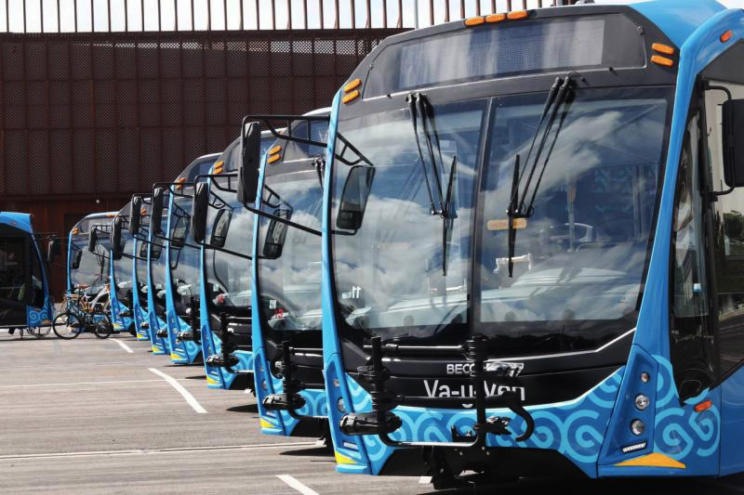
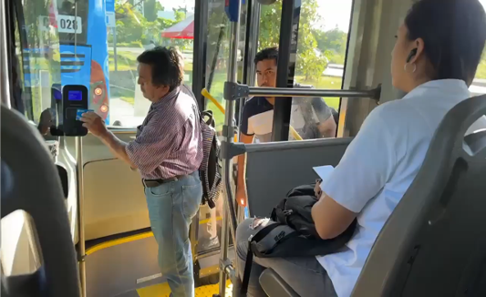
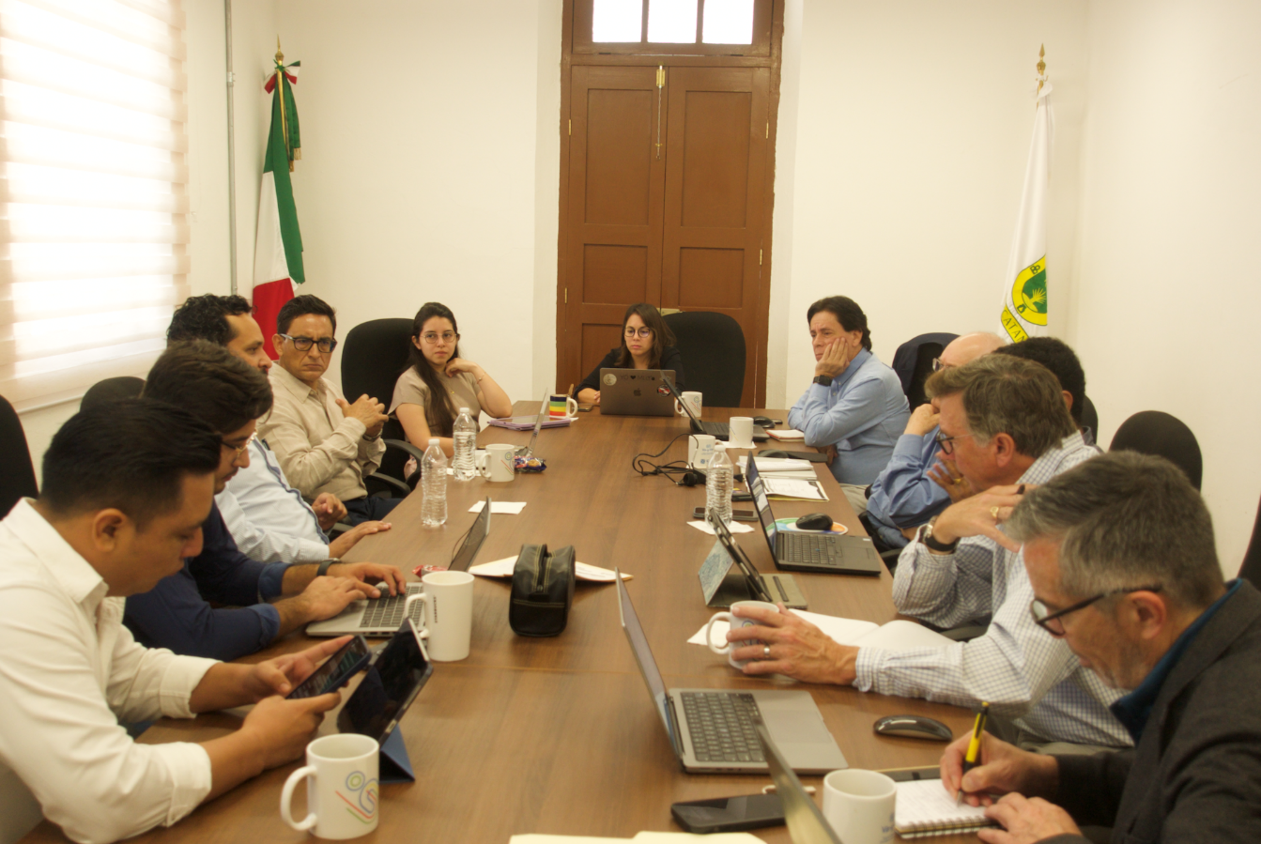
THE STRENGTH OF THE SYSTEM CONSISTS OF 3 PILLARS
The establishment of the Yucatán Transportation Agency, through the constitutional amendment of September 12, 2022, has enhanced institutional integrity and legal certainty. This autonomous entity is specifically tasked with regulating state transportation, including the management of public transport fares and concessions. The agency’s autonomy ensures long-term stability and reinforces its capacity to make independent and effective decisions.
INSTITUTIONAL STRENGTH AND LEGAL CERTAINLY
The system employs per-kilometer payments to ensure fair cost distribution. It has transitioned to corporate management to enhance professional oversight. A transparent trust fund manages the collection of tariffs and state contributions, governed by its own rules to ensure accountability and efficient payment processes. Additionally, an electronic fare collection system improves efficiency and minimizes fraud, while a fleet management system optimizes operations and reduces costs.
FINANCIAL STRENGTH
The system features a modern bus fleet, advanced technology, improved accessibility, environmentally friendly operations, better working conditions for drivers, and ongoing training programs to maintain high service quality.
Operational strength

Slide 8
THE BIG CHALLENGE
ECONOMICALLY POSSIBLE
ENVIRONMENTALLY FRIENDLY
SOCIALLY FEASIBLE

Slide 9
INSTITUTIONAL CHALLENGES
LEGAL
FINANCIAL
OPERATIVE
Establishing legal certainty
Creating an autonomous agency independent of government changes
Revising the concession model
Establishing financial foundations
Gaining key powers, such as defining tariffs and managing concessions
Creating a trust fund to provide financial certainty and security for both banks and concessionaires
A 10-year concession model that secures credit for the fleet
Securing financing for fleet renovation
Establishing a centralized fare collection system with payments based on kilometers
Renewal of the bus fleet
Absence of training programs and a system for evaluating and providing feedback to drivers
Adapting electric vehicle operations to the Yucatán climate
Implementing charging infrastructure
Digitalizing public transportation
Uncertainty regarding drivers, working conditions

Slide 10
ONE MORE CHALLENGE…QUALITY
1
2
3
DRIVERS
CITIZEN ATTENTION
QUALITY AND PROCESSES
Absence of training programs
Resistance to change
No system for evaluating drivers and providing feedback
Unclear working conditions for drivers
Ineffective communication channels
No established processes for monitoring and resolving issues
Mistrust from users
No studies conducted to measure user satisfaction
Absence of clear action protocols
Lack of an organizational culture within operating companies
Disconnection between processes and users’ needs
Limited evaluation mechanisms for service quality

Slide 11
Agencia de Transporte de Yucatán
Rafael Hernández Kotasek
Agencia_ATY
Kotasek_Rafa

